Slide 1
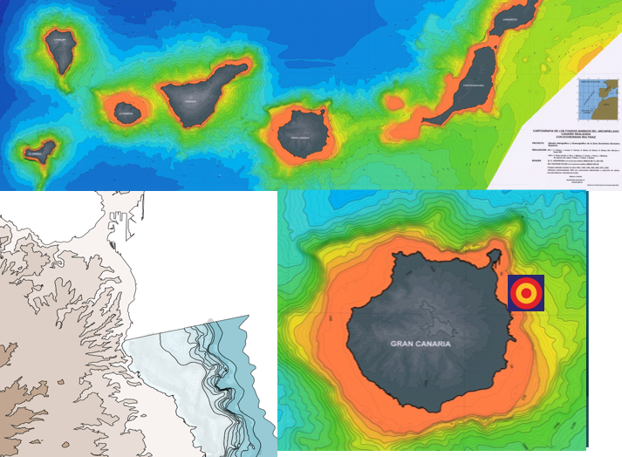
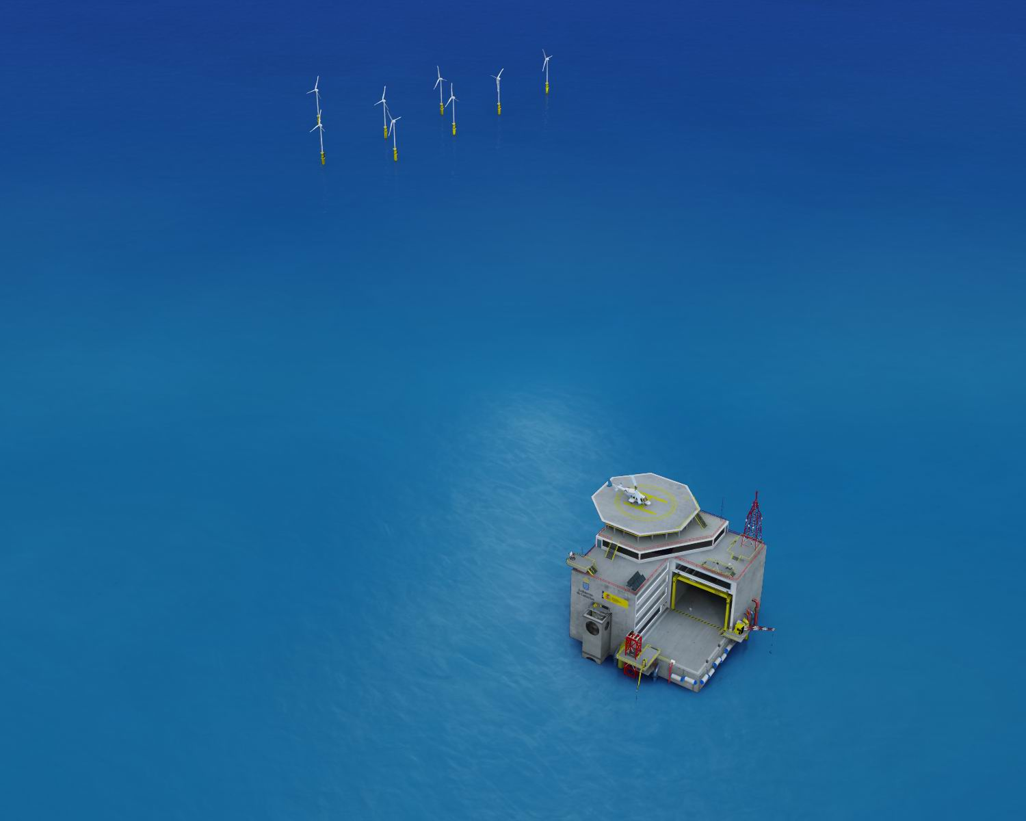
Multi-use offshore infraestructures and services
Observatory
Testbed
Underwater
vehicles
Training centre
PLOCAN
Platform of innovation
Dr. Joaquín Hernández-Brito
Notes:
PLEASE MAKE COMMENTS ON WHAT TO ADD OR DETRACT

Slide 2

National Government
50 M€
2007-2010
Regional Government
PLOCAN
TO facilitate and accelerate:
  Ocean research activities
  Ocean technology development
  Socioeconomic competitiveness of the industry and SME

Slide 3
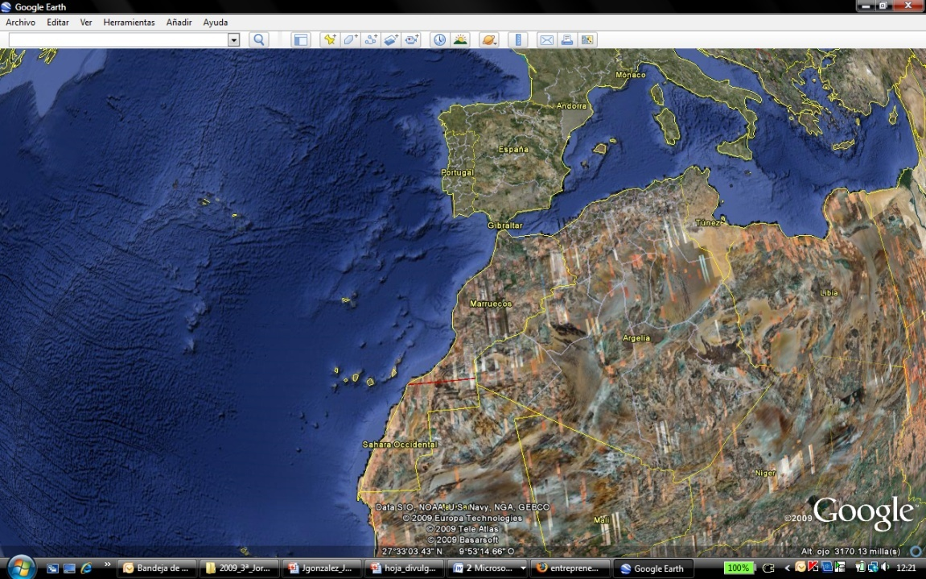
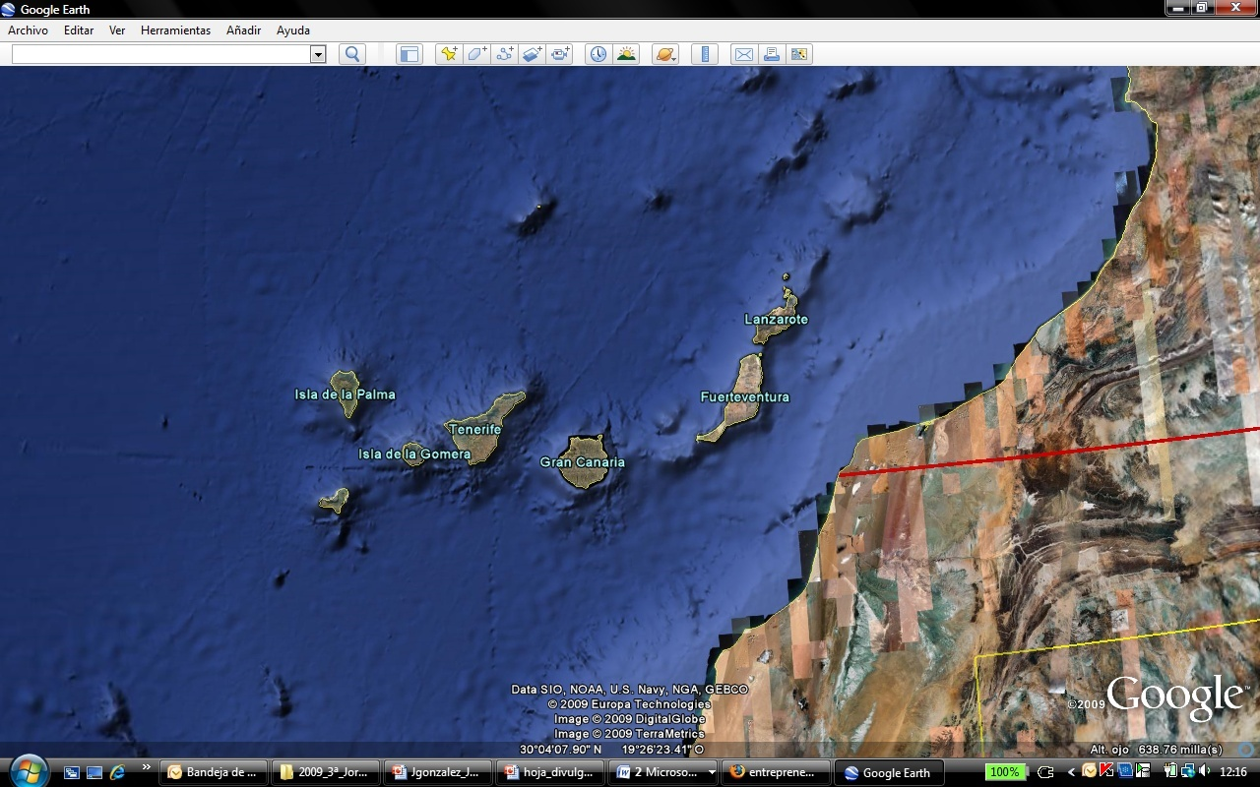
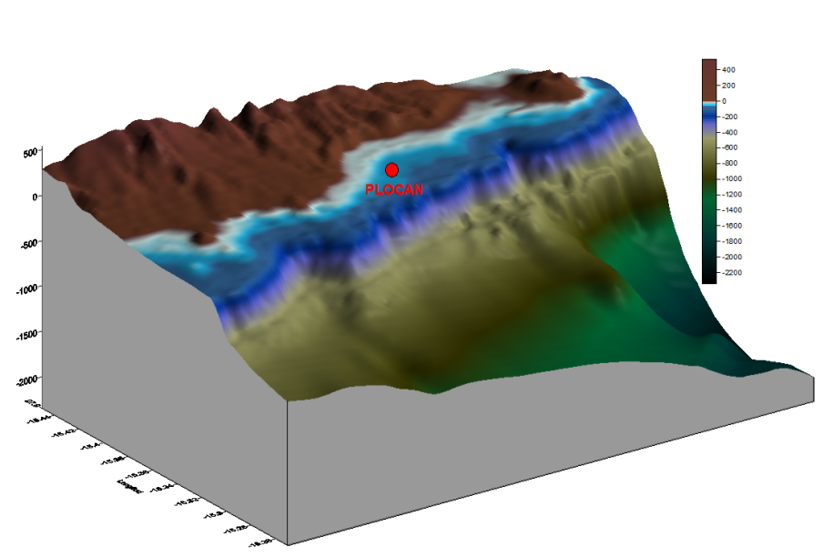
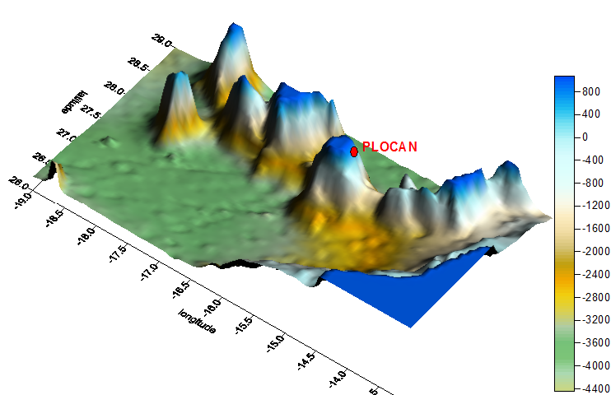
¿where we are?
Canary Islands

Slide 4
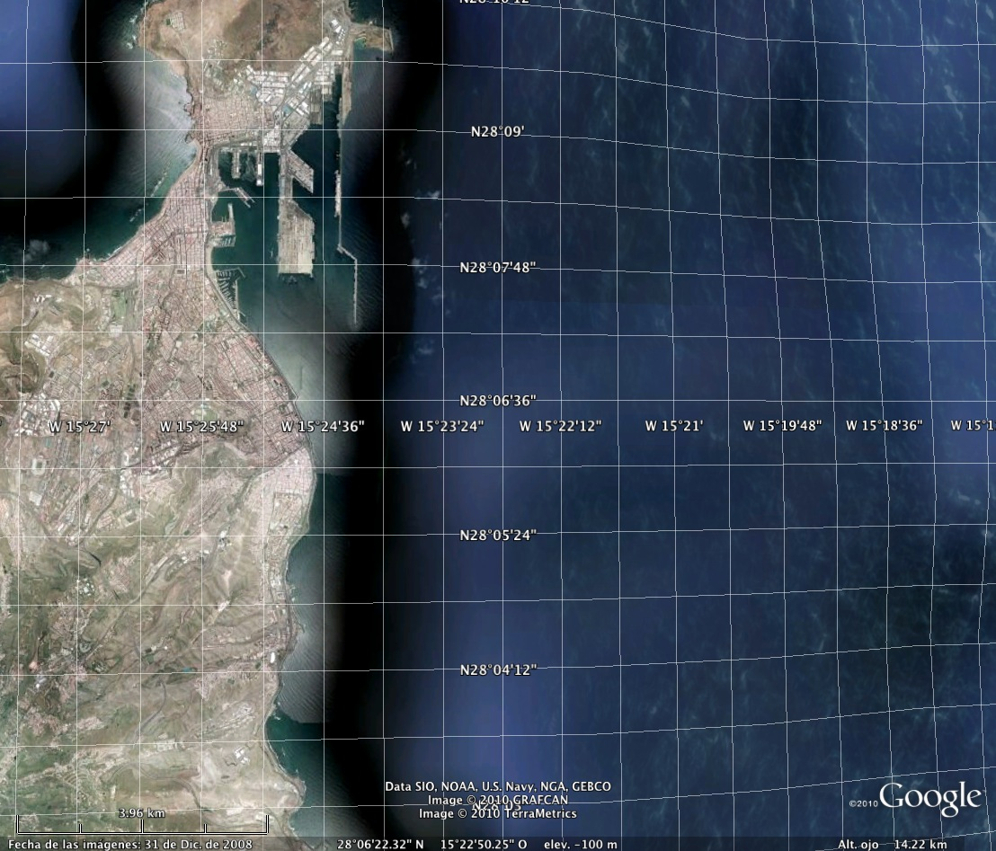
Las Palmas Port
1.500.000 TEU per year
22 weekly direct lines with west Africa.
Leads the fuel supply in the Mid-Atlantic
1st Ships repairs
500 M€ turnover activity

Slide 5
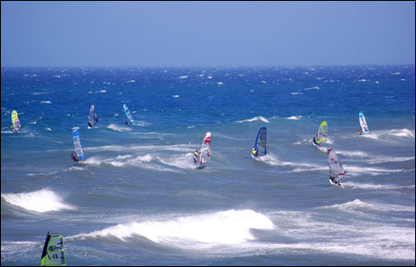
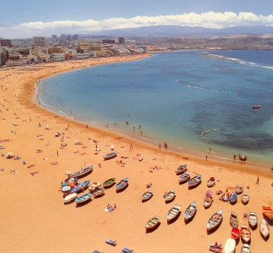
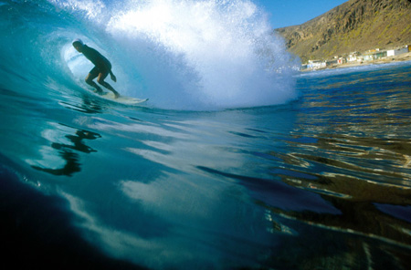
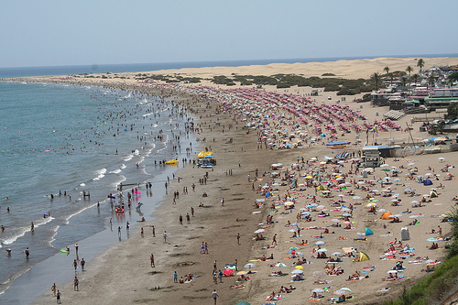

Slide 6
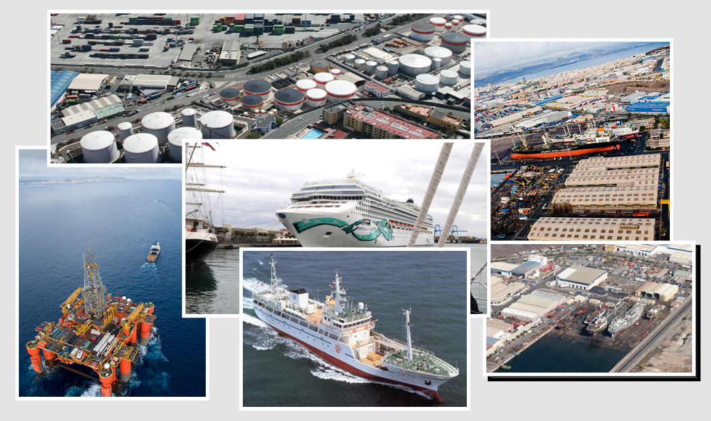
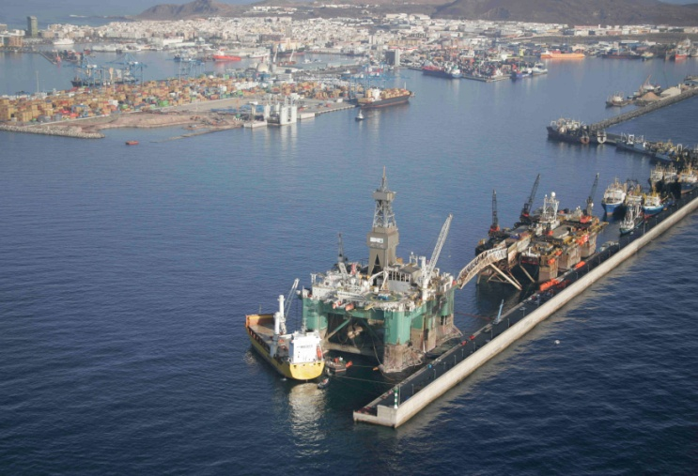
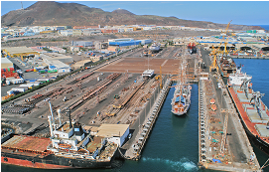
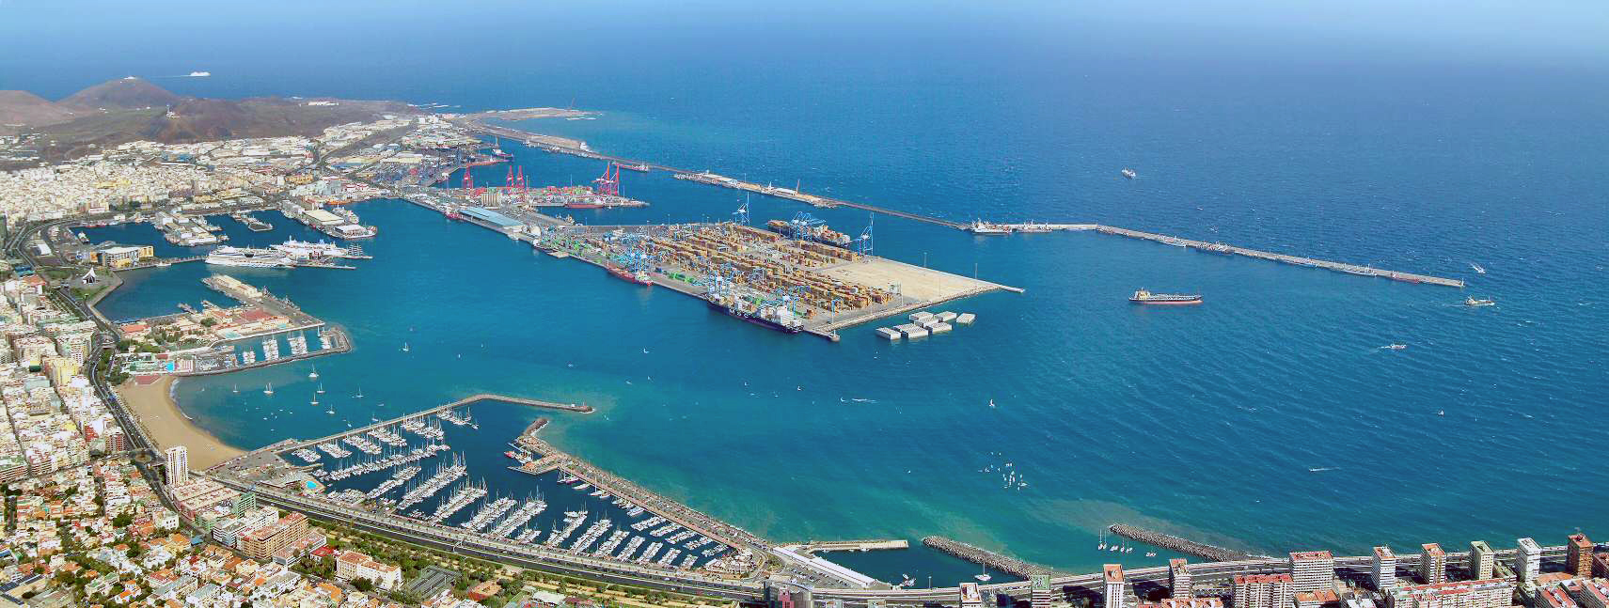

Slide 7
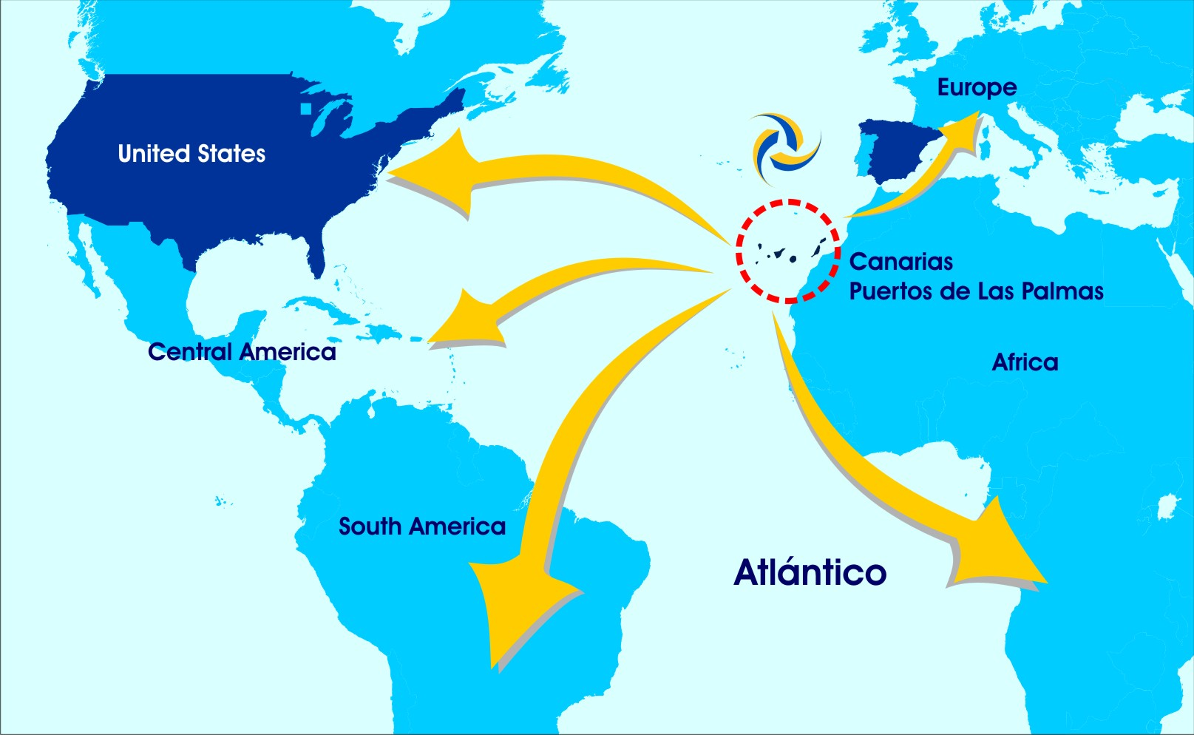

Slide 8
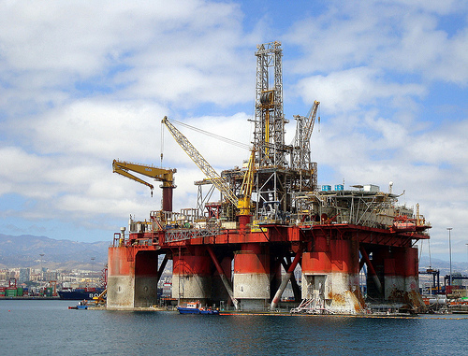
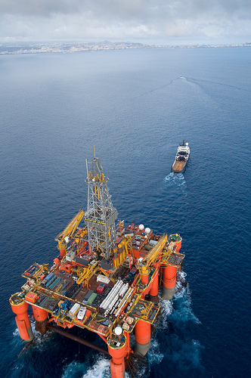
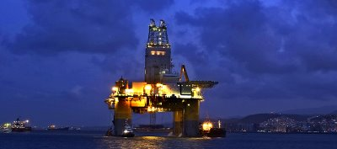

Slide 9
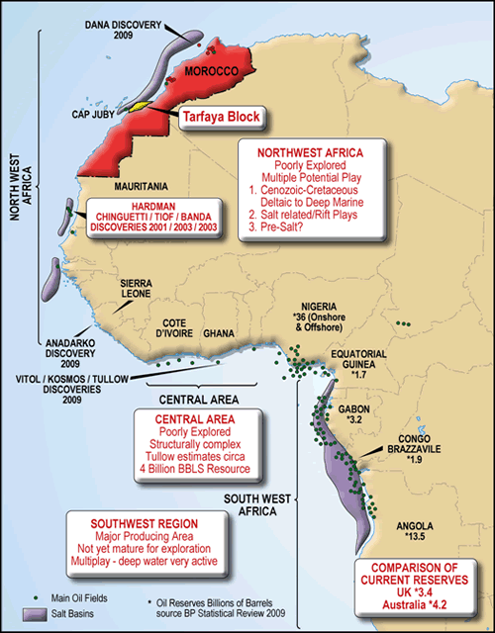
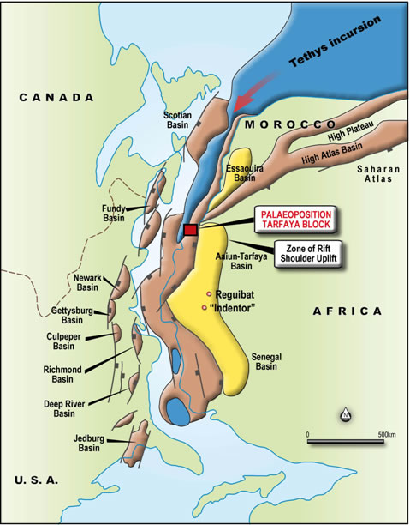

Slide 10
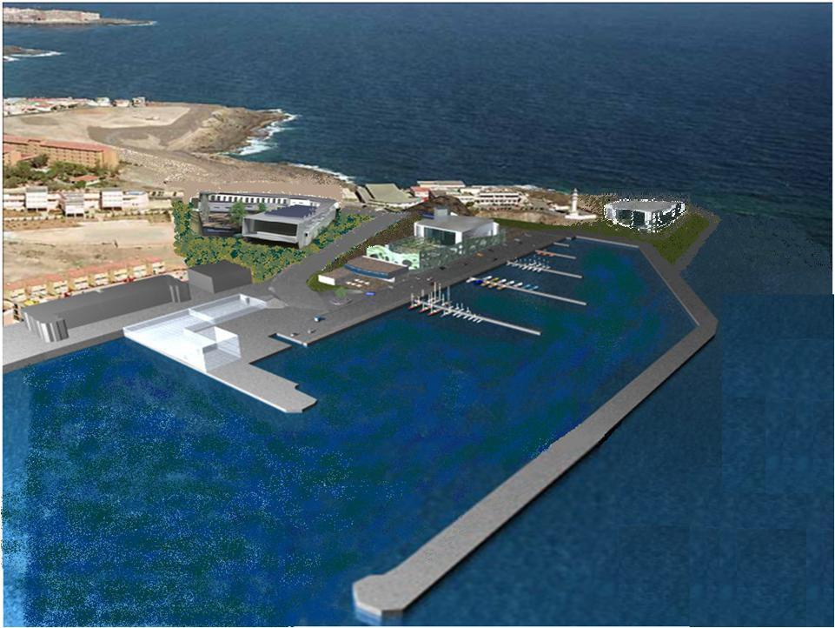
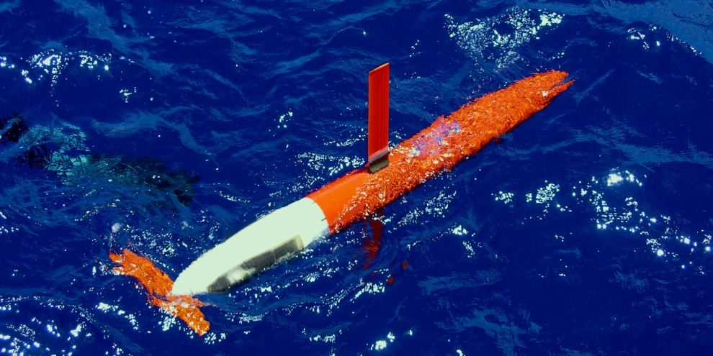
¿What INFRASTRUCTURES?

Slide 11
Ocean observatory
Testbed
Base for underwater
vehicles
Training centre
PLOCAN
Platform of innovation

Slide 12
Business together?
platforms?
energy vectors?
hydrogen?
cables?
applications?
new materials?
antifouling?
risk analysis?
environmental?
certification?
new materials?
models?
?
Ocean observatory
Testbed
Base for underwater
vehicles
Training centre
PLOCAN
Platform of innovation

Slide 13
Testbed for ocean energy converters
Ocean energy converters and associated components
  Offshore wind and wave energy converters
  Structural components
  Mooring systems
  Clean energy vectors
Integral Project Management
  Rise R&D funding
  Administrative permits, certifications
  Environmental protection guarantee
  Link with other providers of services
  Transportation, customs

Slide 14
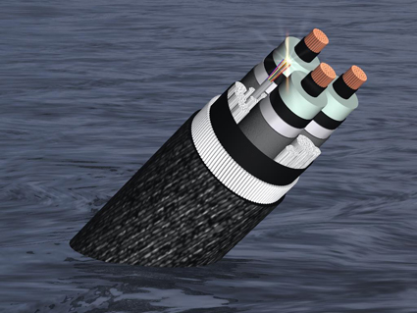
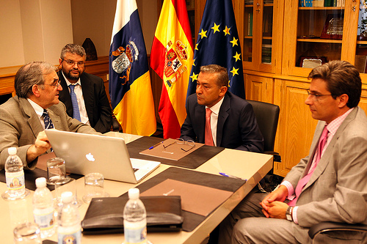
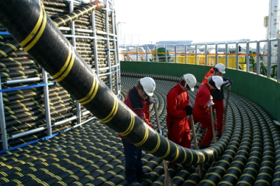
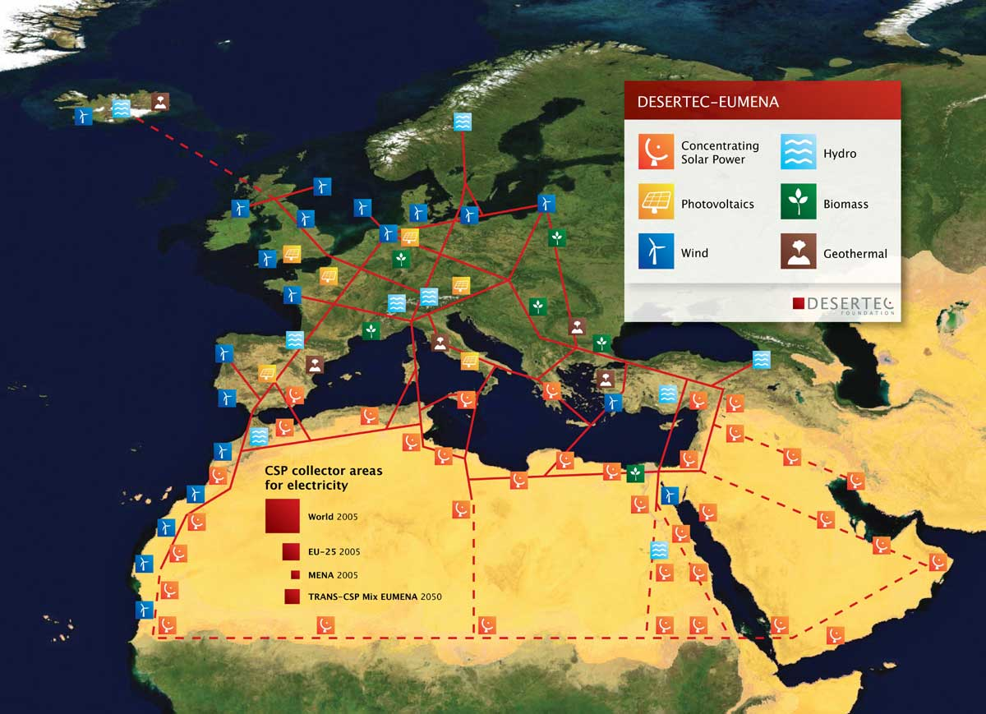
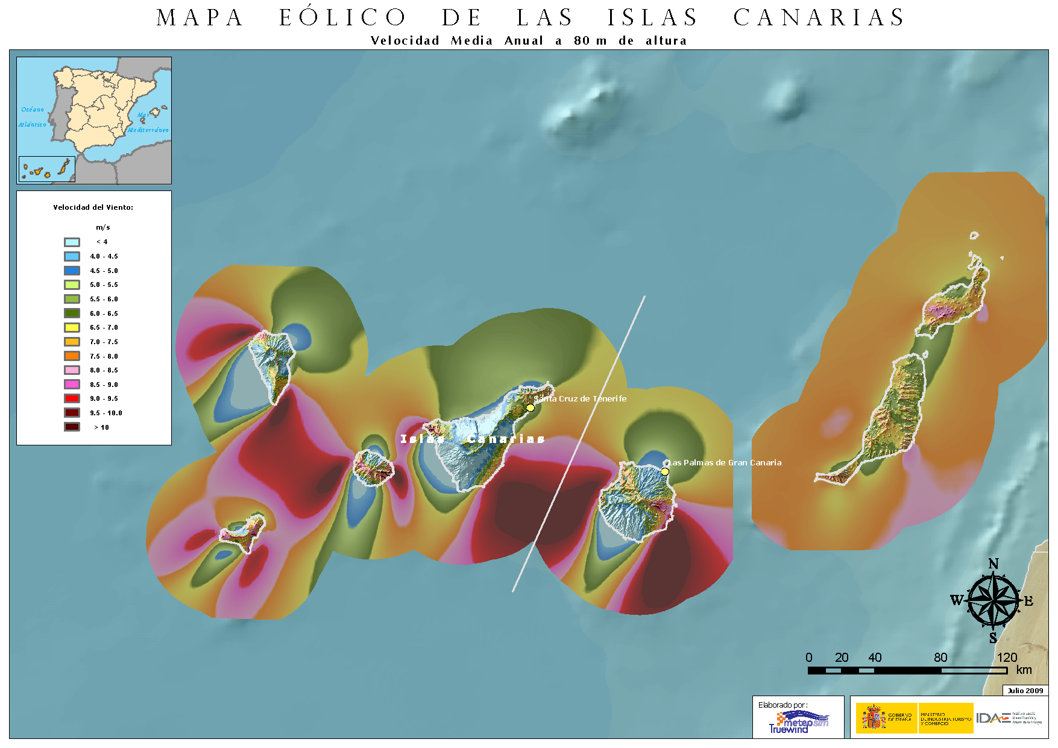

Slide 15
Testbed environment - Wind speed
Annual average wind speed – height: 80 m
Mesomap
Meso Inc.

Slide 16
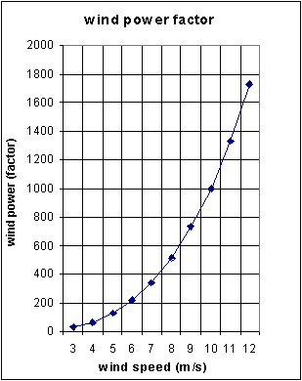
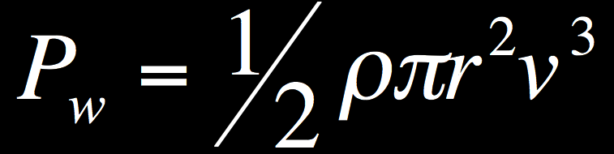
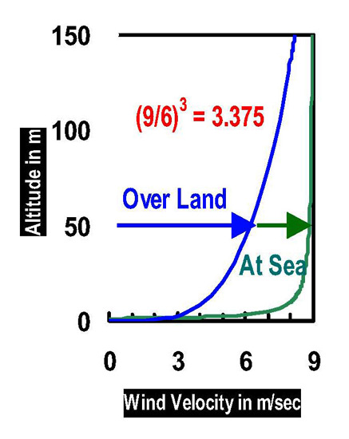

Slide 17
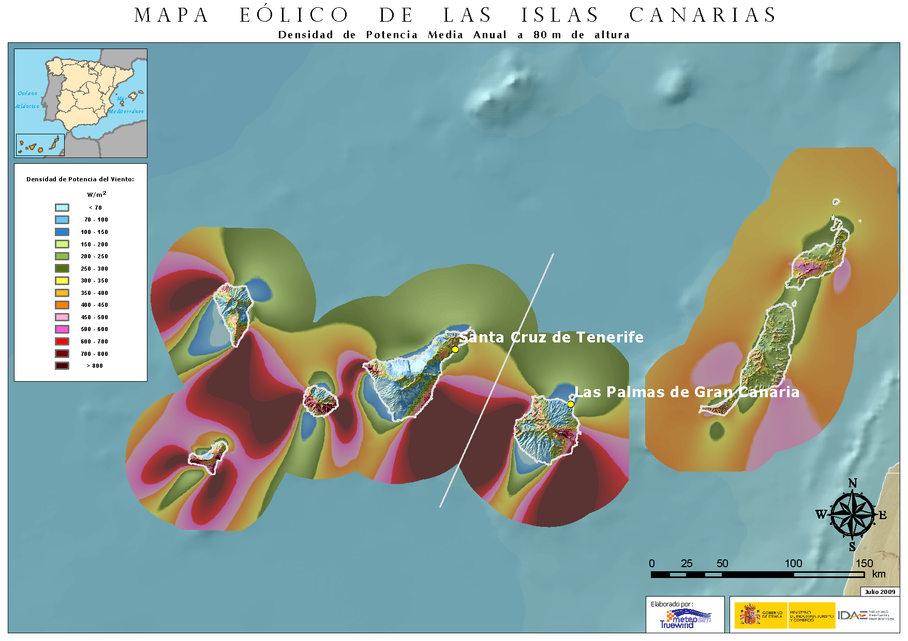
Testbedenvironment - Windpower
Annual average wind power density – height: 80 m
Mesomap
Meso Inc.

Slide 18
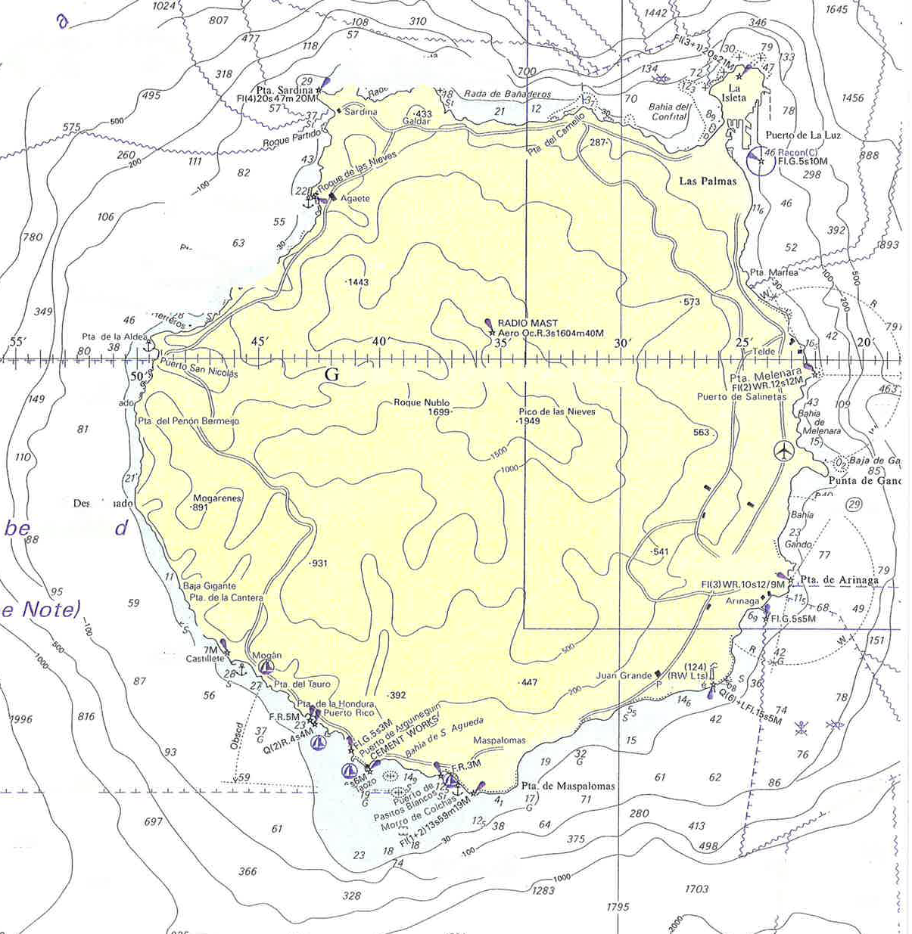
The enormous potential off Gran Canary
1GW 65 units windpark 5km off the coast

Slide 19
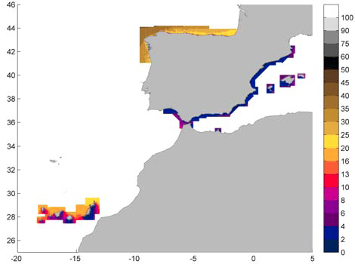
Wave energyresource
Spanish Wave Power ATLAS
20 kW/m
10 kW/m

Slide 20

Regional Energetic Strategy
REGIONAL LEVEL
Objectives:
Improvement of infrastructures
Renewable energies producing the 30% of total energetic production in 2015
Installing a total capacity in 2015 of:
Wind : 1025 MW Waves : 50 MW
Under revision + 600MW
National Energetic Strategy
NATIONAL LEVEL
  National Renewable Energies Action Plan 2011-2020:
    22,7% of total energy consumption coming from renewable energies
    42,3 % of total electric energy produced coming from renewable energies
    Wind : 38.000 MW Waves : 100 MW

Slide 21

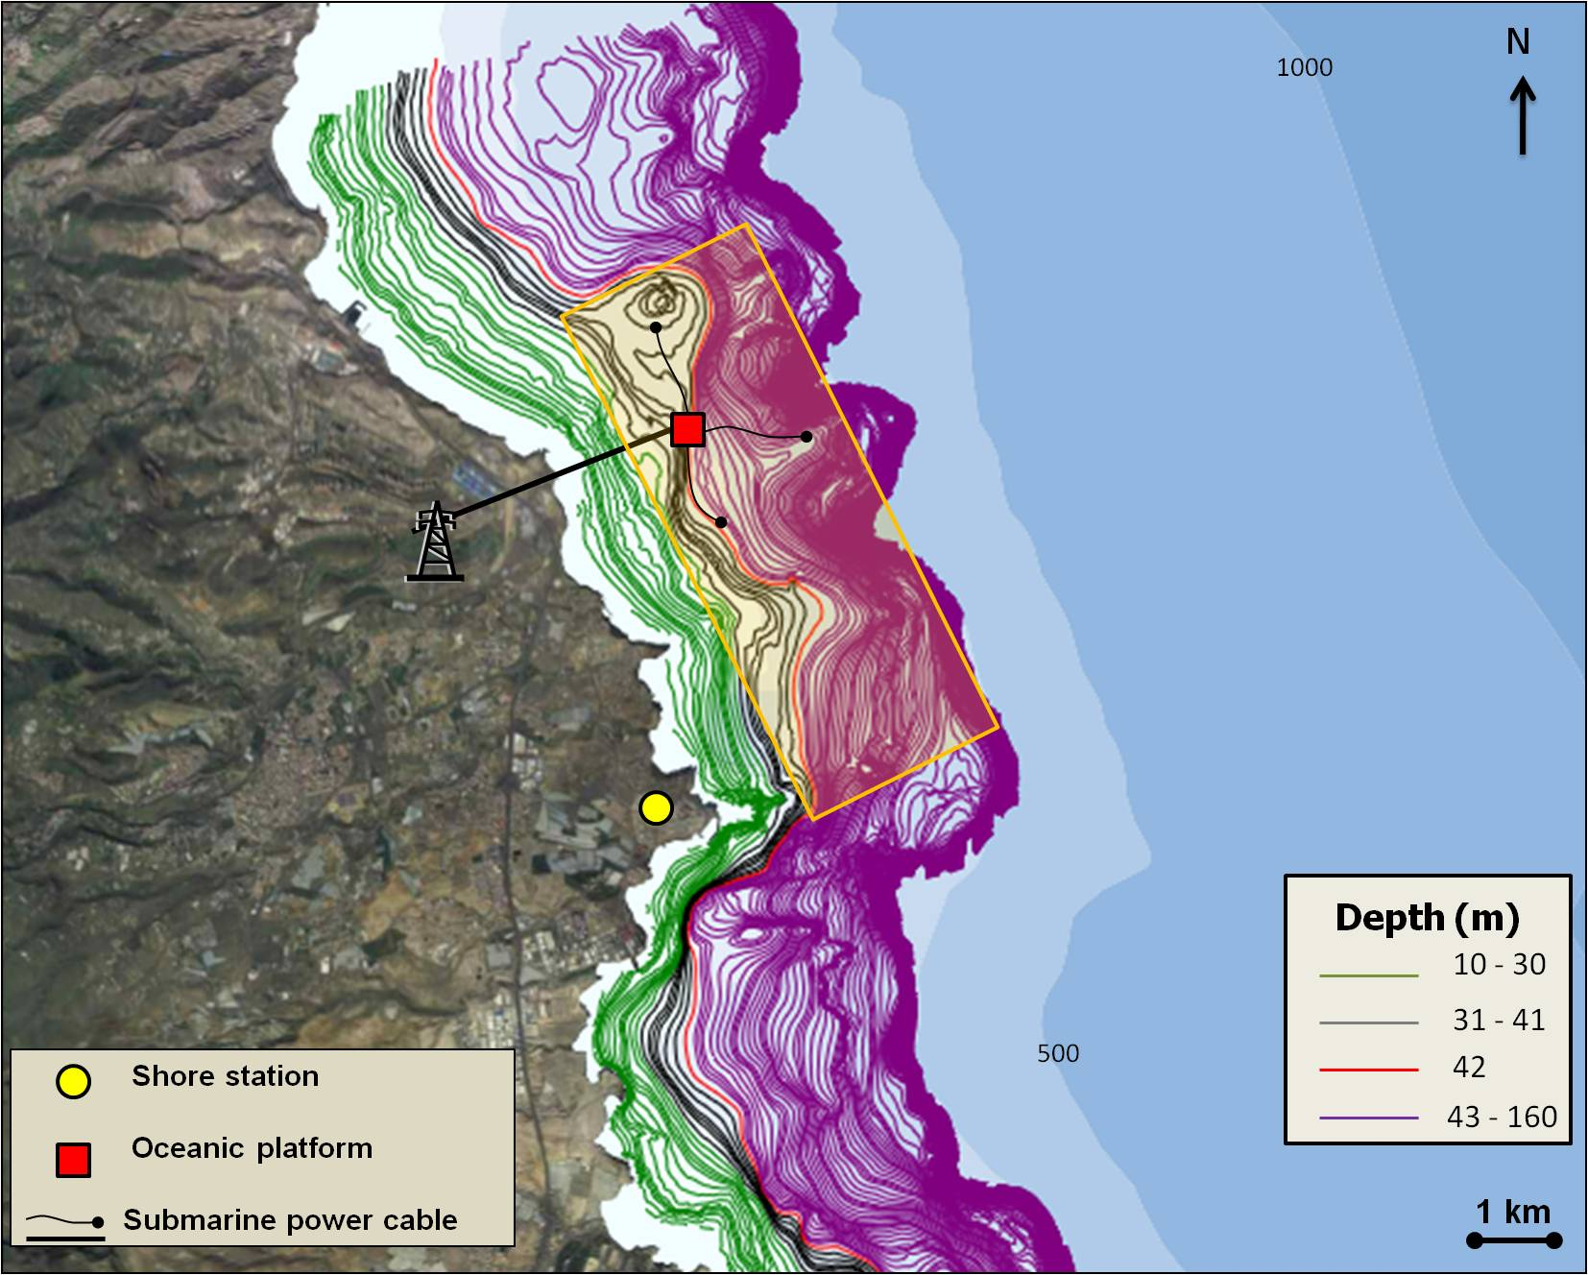
Area
Dimensions: 4 km * 2 km (with a future ampliation planned)
Depth: 30 - 200 m
Shore distance: 3 - 5 km
Mid-scale power conditions
Weather conditions allow
operation during the whole year
No interactions with other
marine activities

Slide 22
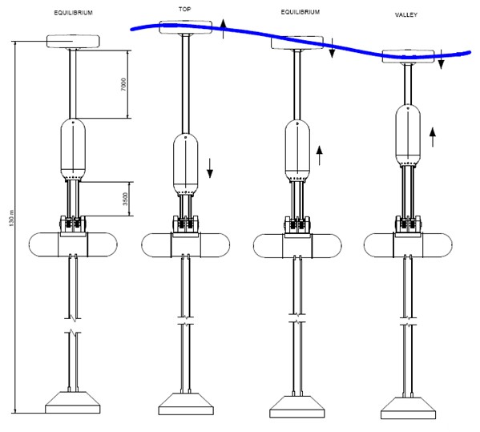
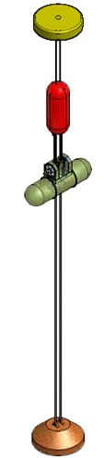


Slide 23
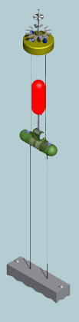
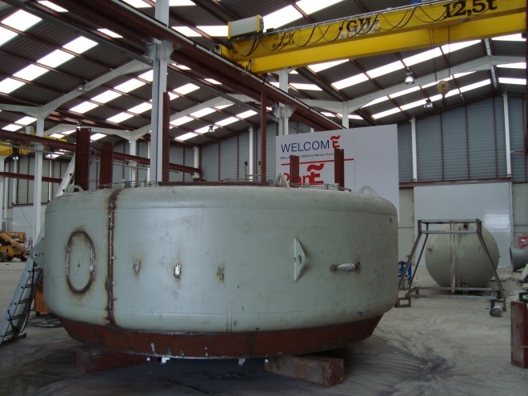
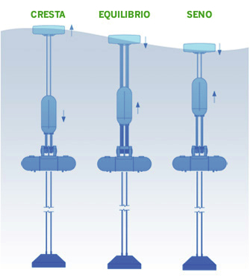
WELCOME Project
Prototype
- Scale 1:5
- Maximum power: 70 kW
-Full scale: 1,6 MW / buoy
3 principles of working
- free surface movement (surface buoy)
underwater pressure (variable volumen buoy)
overtopping (not implemented yet)
CEIB
ANORTEC
PIPO SYSTEMS
PLOCAN
APC-PISYS
Surface buoy
Variable volumen buoy
Machinery buoy
http://www.piposystems.com/
anchor

Slide 24
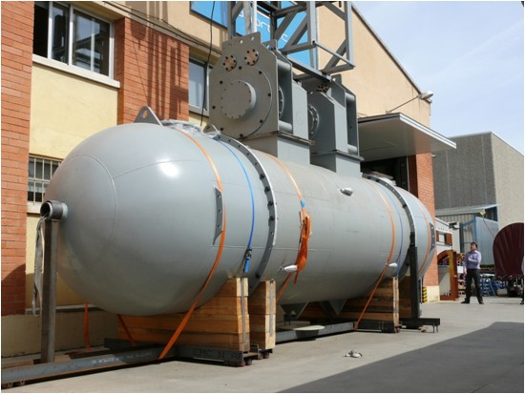
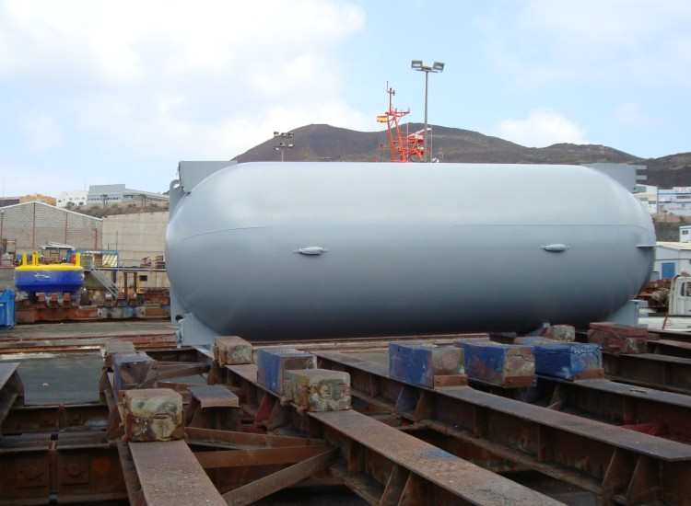
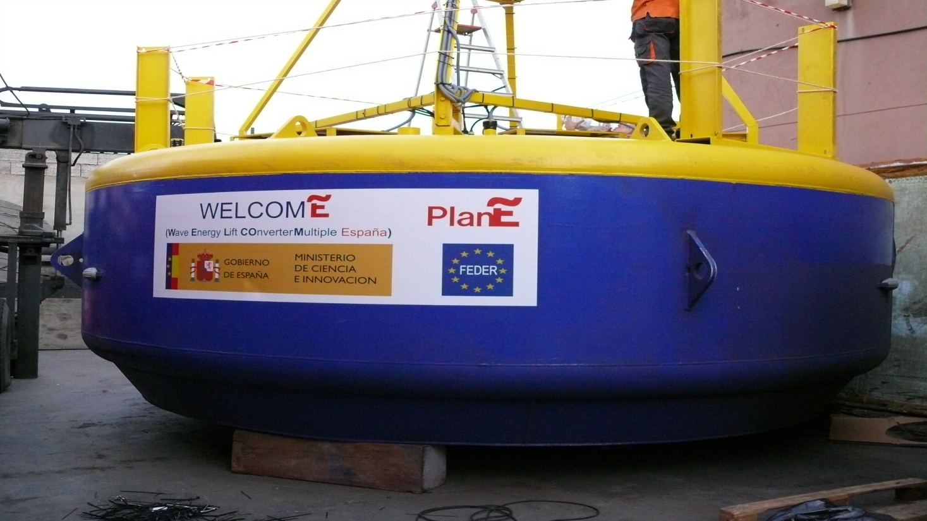
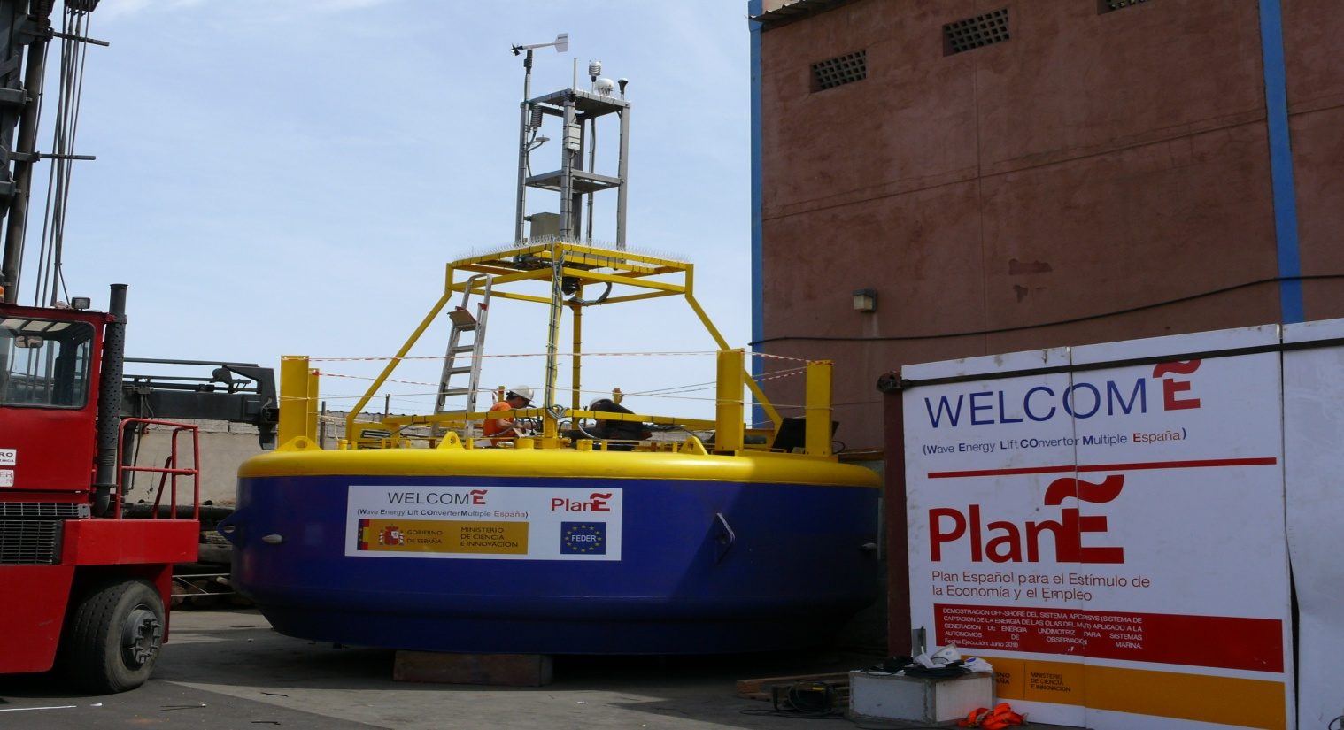
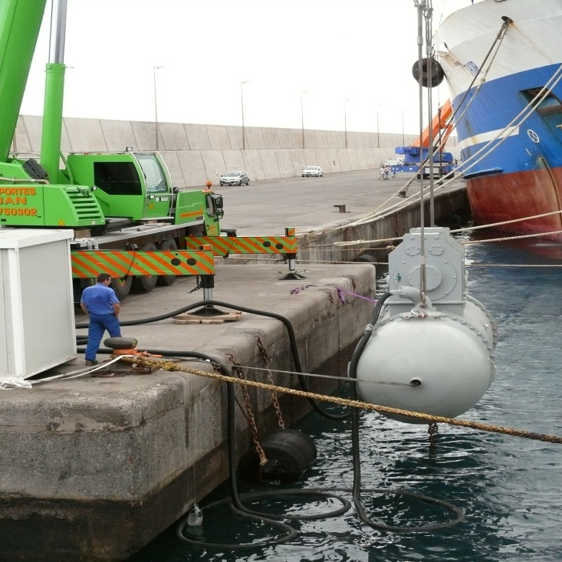
Current status:

Slide 25
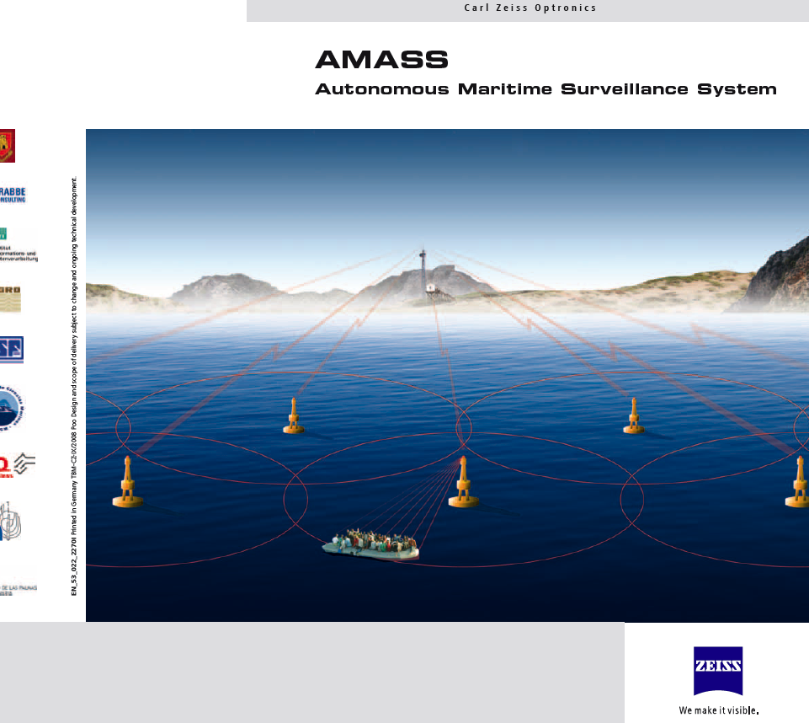




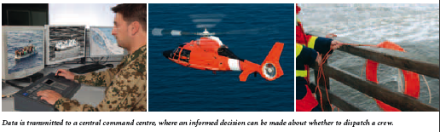
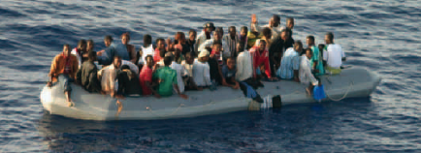




Slide 26
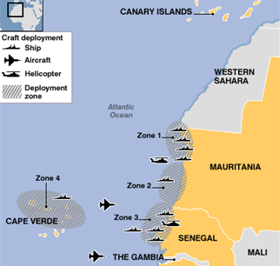
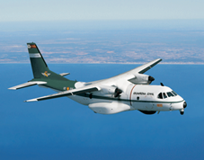






Slide 27










Slide 28






Slide 29



Modular Multi-use Offshore Platform to Harness Ocean Resources in Tropical and Subtropical Areas
Work Programmes | Theme 2: Food, Agriculture... Theme 5: Energy Theme 6: Environment Theme 7: Transport
CALL: FP7-OCEAN-2011 | “OCEAN OF TOMORROW”-Joiningresearchforcestomeetchallenges in oceanmanagement
TOPIC: OCEAN. 2011.1 | “Multi-use offshore platforms”
Dr. Joaquín Hernández-Brito joaquin.brito@plocan.eu

Slide 30
PROPOSAL CONCEPT
Multiuse Oceanic Platform: Wind and wave energy + aquaculture + transportation
Design for Atlantic sites to operate efficiently in areas where the marine energy resources offer a medium-low potential
Modular approach, a core with operational modules
Sustainable and eco-friendly
Applicability to outermost regions
Proposal preparation – Kick off meeting – October 21, 2010

Slide 31

PRELIMINARY WORK PACKAGES DIAGRAM:
Proposal preparation – Kick off meeting – October 21, 2010

Slide 32
Business together?
new sensors?
power supply?
nanotech?
applications?
new materials?
antifouling?
intelligence?
risk analysis?
consumption?
interface?
microsystems?
communications?
?
Ocean observatory
Testbed
Base for underwater
vehicles
Training centre
PLOCAN
Platform of innovation

Slide 33



Underwater vehicles
Remote operated vehicle (ROV):
  DeepOcean Swordfish: working class depth up to 600 m (under contract with SGM)
  Bleeper pro AT
  Manufactured by Praesentis (Barcelona, SPAIN)

Slide 34




Autonomous Underwater Vehicle (AUVs)
  Glider SPRAY - Bluefin (USA)
  Seaglider - irobot (USA)
  Slocum glider -Teledyne Webb Research (USA)
Next Acquisition
Gavia 1000 – Hafmynd (Iceland)

Slide 35



SERVICES:
SUPPORT TO GLIDERS and AUVS: Launch, Tracking, Recovery
CONTROL ROOM: Real-Time Data Monitoring

Slide 36


Slide 37
Science together?
observatories?
processes?
atlantics?
protocols?
data ?
mobility?
infrastructure?
acoustics?
CO2?
Circulation?
seismic?
Oil pollution?
?
Ocean observatory
Testbed
Base for underwater
vehicles
Training centre
PLOCAN
Platform of innovation

Slide 38
SCIENCE, TECHNOLOGY AND INNOVATION
Climate change and ocean acidification
Ecosystem and biogeochemical variability
Support sustainable use of the oceans
Geohazards and seafloor exploration
Ocean engineering and marine technology
  Marine energy
  Underwater vehicles
  Sensors, new materials
  Cyber-structure
Contribute to support long term observations in the region (Esonet, Emso, Eurosites, etc.)
Enhanced academic-industry partnership

Slide 39

Existing and planned capacities
Coastal node
Conductivity
Current
Temperature
Oxygen
Turbidity
Pressure (High precision)
Fluorescence
Passive acoustics
Acidity
Carbon dioxide
Fauna
Seismic
Geophysics

Slide 40

Existing and planned capacities
Coastal node

Slide 41


Existing and planned capacities
Regional node (ICCM/ESTOC)

Slide 42


European Station for Time Series in the Ocean ESTOC
More than 30 institutions
More than 500 researchers
Contribute to EuroSITES deep-ocean observatories network
Variability of the physics, chemistry and biology
Trends over decadal time scales
Feed meteorological and oceanic models
Study middle-size structures
New technologies

Slide 43




European Station for Time Series in the Ocean ESTOC

Slide 44













SINGULARITIES
BIODIVERSITY

Slide 45





Slide 46

SINGULARITIES

Slide 47


Slide 48


Marine Environment and Security for the European Area MERSEA
Development of a European system for operational monitoring and forecasting of the ocean physics, biogeochemistry, and ecosystems, on global and regional scales.
Ocean climate variability studies
Improve national security and reduce risks
Improve the safety and efficiency of maritime transport
Mitigate the effects of environmental hazards and pollution crisis
Research about the global climate, the ocean and its ecosystems.
Sustainable exploitation and management of ocean resources

Slide 49


Slide 50


Slide 51


Slide 52


Marine Carbon Sources and Sinks Assessment CARBOOCEAN
North Atlantic and Southern Ocean CO₂ air-sea exchange
Detection Atlantic and Southern Ocean carbon inventory changes
Carbon uptake and release at European regional scale
Biogeochemical feedbacks on the oceanic carbon sink
Future scenarios for marine carbon sources and sinks

Slide 53












Coordinate with global framework
INGV
Creation of a IOC/SCOR Working Group

Slide 54



Thank you !
Plocan Team at www.plocan.eu
joaquin@brito.com

Slide 55





¿Memorandum of understanding to benefit from each other's expertise in marine technology ?
Partnership in projects
Training and technology transfer initiatives
Curriculum and program development
Student and faculty exchange
Project activity related to applied
Research and development activity.

Slide 56






Exchange of students /joint actions

Slide 57
Coordinate with global framework
INGV
Creation of a IOC/SCOR Working Group

Slide 58


