Slide 1


CCSDS121-based High-Performance Hardware
Architecture for Real-Time Data Compression
Samuel Torres Fau, Antonio J. Sánchez, Yubal Barrios and Roberto Sarmiento
5th October 2023

Slide 2
Contents
Introduction and motivation
Architecture
Verification and synthesis
Conclusions
Context and background

Slide 3



Why is on-board compression needed?
On-board
Compression
EO Mission
Introduction
Compressed
data
Original data
Downlink
Earth decompression
The number of sensors included in satellites and the resolution of the captured information are continuously increasing
  Higher data processing throughput and longer transmission periods.
Additional challenges
  Available hardware resources are scarce
  Limited power
  Transmission links are slow
On-board compression rises as a solution
Notes:
Lossless → the image can be fully recovered after decompression
Lossy → the resulting image is not identical to the original one

Slide 4
Problem
Modern on-board cameras
  Data throughputs up to 8 Gbps or even higher
  Its is crucial to minimize the data storage size and/or the transmissions times
  Lossless compression is commonly preferred
Already existing data compressors can’t handle these throughputs.
  SHyLoC 121.0 ~2.6 Gbps (~160 MHz)
  SHyLoC 123.0 ~2.5 Gbps (~150 MHz)
Development of a new high-performance data compressor
  Minimize hardware occupancy
Parallel processing
Notes:
Lossless → the image can be fully recovered after decompression
Lossy → the resulting image is not identical to the original one
Como comentaba, los sensores actuales y mas en concreto las cámaras, pueden generar flujos de datos de alrededor de 8 gbps e incluso mayores. Es necesario aplicar compresión, preferiblemente sin pérdidas, para reducir el almacenamiento empleado o bien el tiempo de transmisión de las imágenes tomadas.
Los compresores actuales disponibles no son capaces de alcanzar esas tasas de datos. Por ejemplo, fijándonos en los compresores SHyLoc, que mas adelante explicare con más detenimiento, logran tasas de en torno a 2.5 gbps, con relojes de alrededor de 150 MHz. Podría tratarse de optimizar estos compresores, pero será imposible alcanzar tales tasas de procesamiento.
Es necesario crear una nueva arquitectura, y para poder lograr alto rendimiento debe aplicarse un paradigma como el procesamiento paralelo.

Slide 5

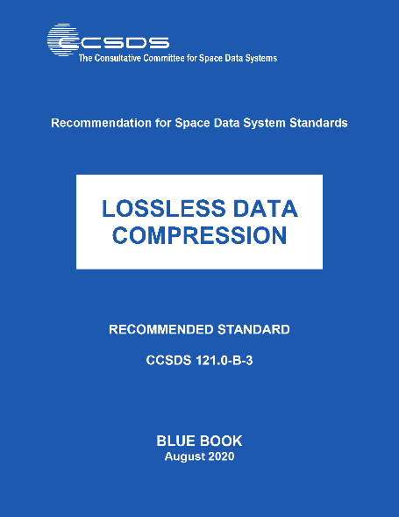
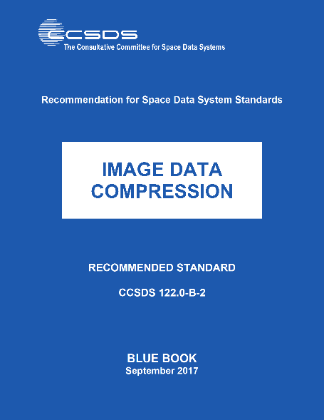
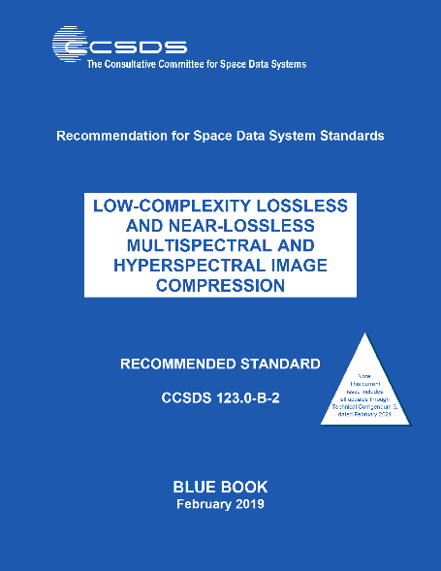
CCSDS Compression Algorithms
Available CCSDS (Consultative Committee for Space Data Systems) data image compression algorithms)
Introduction
CCSDS 121
Lossless universal data compression based on Rice coding
CCSDS 122
2D Compression based on DWT transform
CCSDS 123
Multi and hyperspectral image compression based on prediction
5
Notes:
Consultative Committee for Space Data Systems
Autoridad estandarizadora en el ámbito espacial
Multitud de estándares
Compresión, telemetría, comunicaciones, criptografía…
Interoperabilidad entre diferentes agencias
Y organizaciones como el IUMA

Slide 6
Main objective
Development of a parallel, high-performance CCSDS 121.0-B-3 Compressor
Why using a universal compression algorithm for image compression?
Low complexity algorithm
  Less hardware occupancy
  Allows FPGAs to support multiple subsystems running simultaneously
High throughput
  Modern sensors may generate data throughputs of multiple Gbps
Acceptable compression rate
  ~2x lossless compression
Compliant with standard decompressors
Introduction

Slide 7
Contents
Introduction and motivation
Architecture
Verification and synthesis
Conclusions
Context and background

Slide 8
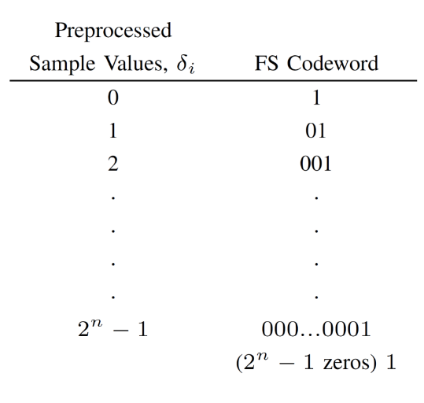
CCSDS 121.0
Block-Adaptive entropy coder
  The optimal coding option is applied to whole J-sample blocks
    J is a configurable parameter (8, 16, 32, 64)
    1 block -> Coded Data Set (CDS) …
    … except for Zero-Block CDS
  All coding options are based on the Rice coding technique
Background
    Subset of Golomb codes
    Hardware-efficient thanks to exclusively use of powers of 2 operations

Slide 9
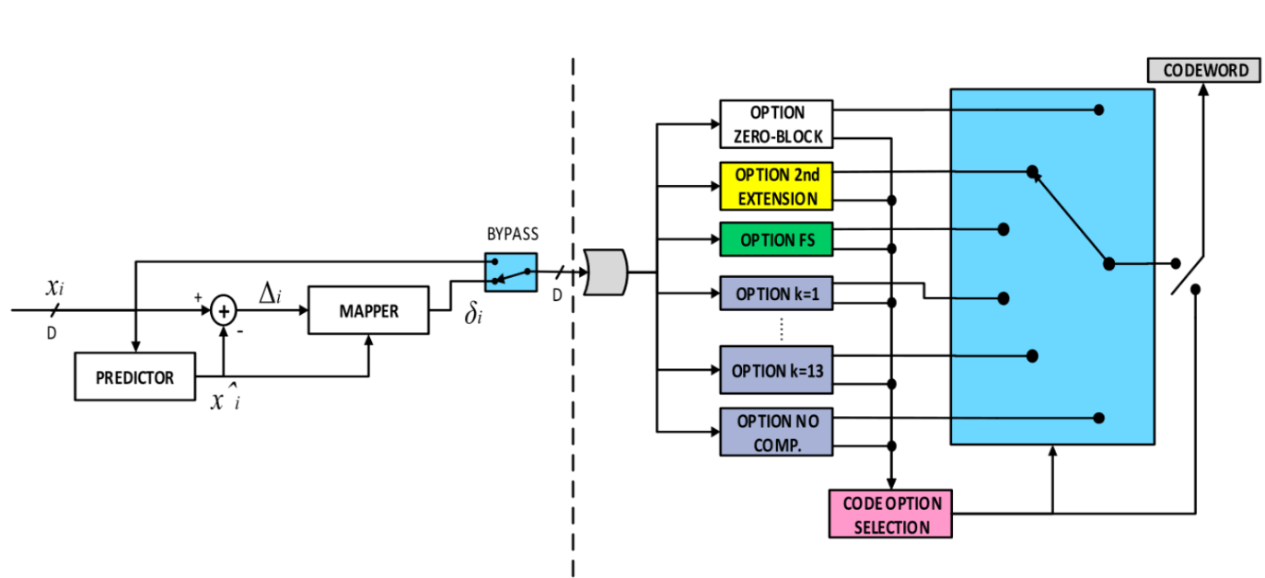
CCSDS 121.0
Block-Adaptive entropy coder
Unit-Delay Predictor
  Optional prediction stage
  Each element predicted with the previous one
    The differences of each consecutive pair of samples are calculated
    The predicted residuals are mapped into unsigned values and forwarded to the coding stage
  Periodic insertion of reference samples
    Helps to limit potential information losses
  Simple predictor
    But somewhat limited…
Background

Slide 10
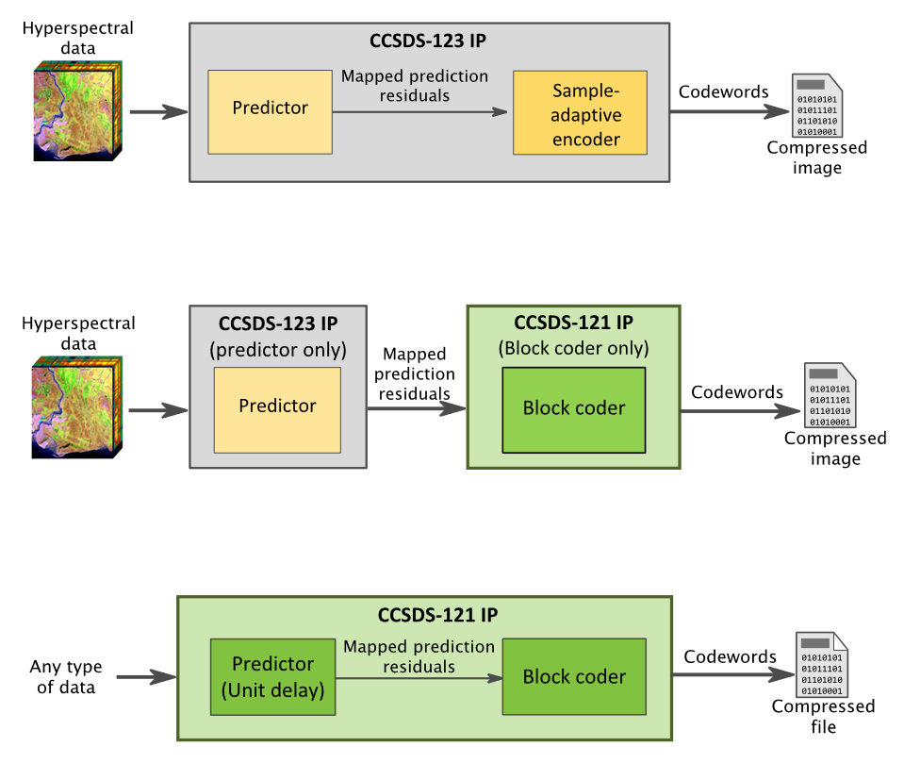
SHyLoC IP Cores
Compression IP Cores developed by IUMA
  SHyLoC CCSDS 121.0-B-3 Compressor Core
  SHyLoC CCSDS 123.0-B-1 Compressor Core
    Multi- and hyperspectral lossless compression
Various possible configurations
  Standalone
  Tandem
SHyLoC CCSDS 121.0-B-3 is the baseline architecture of the proposed design
  The original pipeline has been deeply modified
  Both the predictor and entropy coder have been parallelized
Background

Slide 11
Contents
Introduction and motivation
Architecture
Verification and synthesis
Conclusions
Context and background

Slide 12
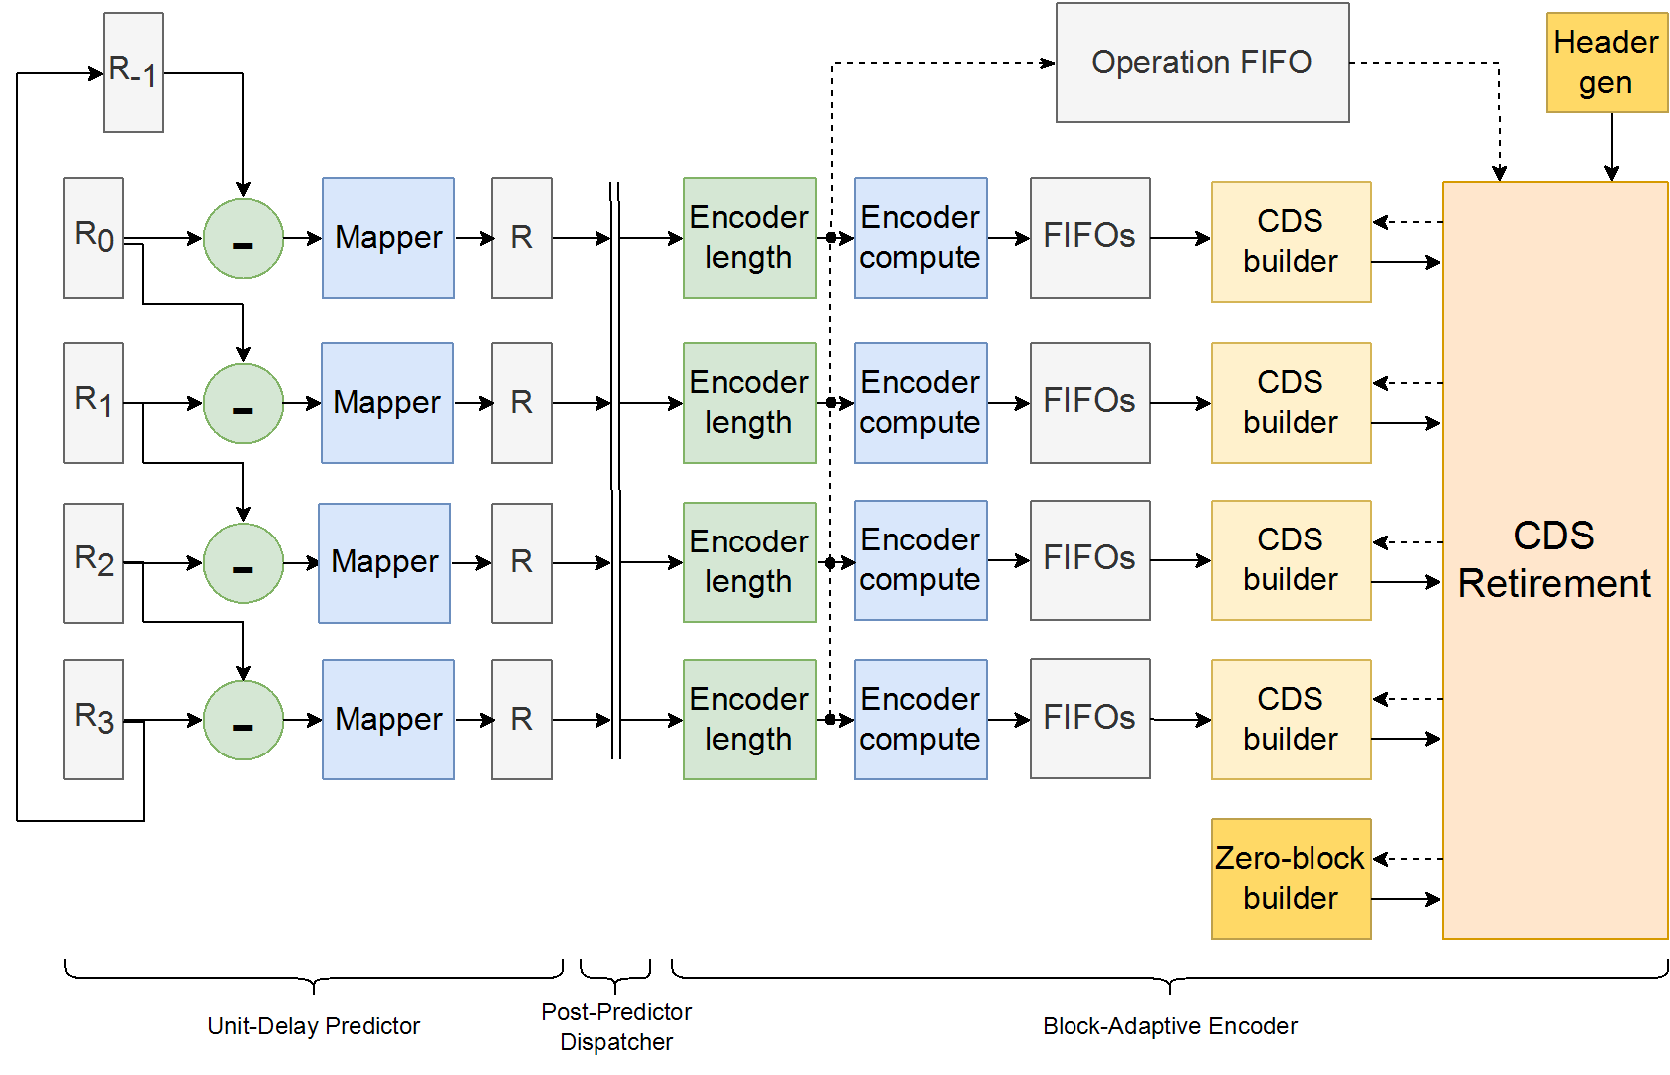
Developed Architecture
Predictor Unit-Delay: The 4 received samples are predicted in parallel
Post-Predictor Dispatcher: Builds complete blocks by accumulating the mapped residuals received from the predictor and dispatches these to the lanes.
Block-Adaptive entropy coder: Encodes the J-Sample blocks and progressively builds the unified output bitstream by gathering information from all the processing lanes.
Architecture
Notes:
The weight vector is updated according to the prediction error.

Slide 13
Developed Architecture
Operation-based control scheme
  Whenever the coding option that will be applied to a block is known, an operation, that contains the minimum information needed to consolidate the corresponding CDS, is generated.
  The coordination of the different processing lanes is significatively eased.
  The generation of Zero-Block CDS is centralized and included in the operation scheme.
Scalability
  Architecture designed to be scalable.
  Introduced generics in the VHDL description to ease the implementation of high-performance architectures.
Architecture
Notes:
The weight vector is updated according to the prediction error.

Slide 14
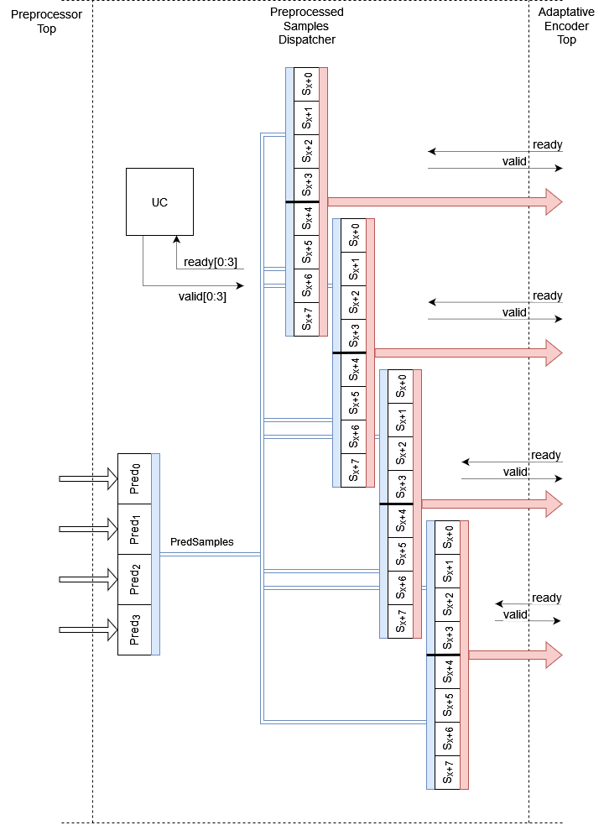
Architecture: Post-Predictor Dispatcher
4 mapped residuals (½ block) are received from the predictor
  These are stored in a cyclic manner
When a complete block is formed (every 2 cycles), this is forwarded to a basic coding lane
Key component
  Communicates blocks that have been parallelized following different methodologies
  Prediction: ½ block is predicted in parallel (4 samples/cycle)
  Encoding: Whole blocks are sequentially processed (1 sample/cycle per coding lane)
Architecture
Notes:
The weight vector is updated according to the prediction error.

Slide 15
Architecture: Block-Adaptive Encoder
Basic coding lanes process blocks sequentially, through 4 well differentiated stages:
  CDS Length calculation and Coding Option Selection
  CDS Codification
  CDS Intermediate Reconstruction
    nFSM3 y CDS Builder
    nFSM3z y Zero Block Builder
  CDS Retirement
    FSM4, Reorder Unit y Retirement Unit
6 parallel processing lanes
  4 basic coding lanes
    Includes all stages
    Scalable
  1 Zero-Blocks coding lane
    Stages 3* and 4
  1 header insertion coding lane
Architecture
Notes:
The weight vector is updated according to the prediction error.

Slide 16
Contents
Introduction and motivation
Architecture
Verification and synthesis
Conclusions
Context and background

Slide 17
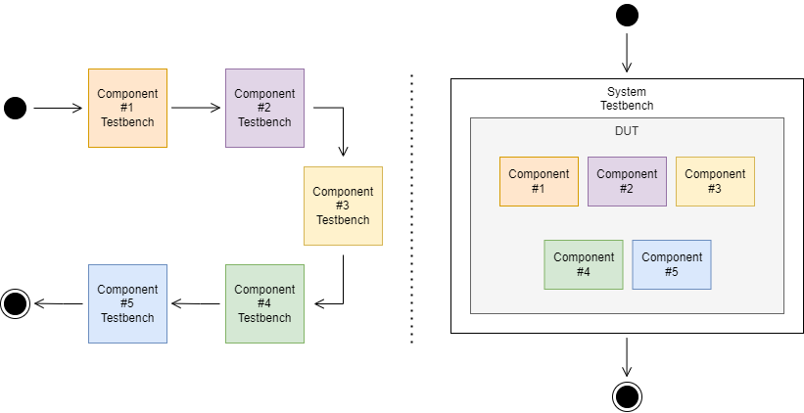
Verification
The verification was carried out in two different phases
  Block-Level verification
    Specific testbench developed to verify individual components/blocks: Custom drivers, monitors and scoreboards
    Unit-Delay Predictor and Post-Predictor Block Dispatcher verified following this methodology
  System-wide verification
    Performed once the system was fully described and integrated
    Large verification campaign
Verification
Notes:
The weight vector is updated according to the prediction error.

Slide 18
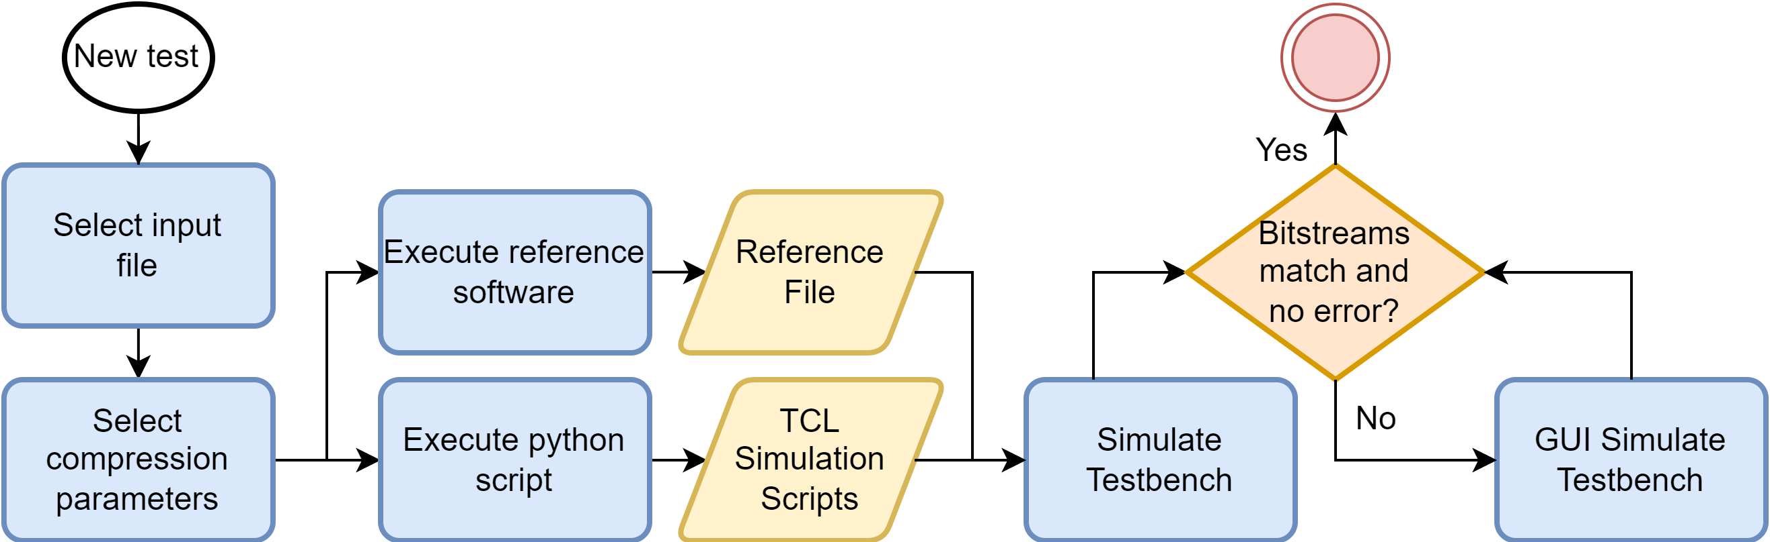
System-wide Verification
Verification of the complete architecture, Gray Box testing
  Instead of individually checking the internal components, demonstrate that the whole system behaves as expected
    Check of IP status signals
    Output bitstream correctness check
  If any problem arises, a more in-depth analysis of the behavior is performed
3 groups of testcases simulated:
  G1 basic tests: reduced set of compression runs with synthetic images
  G2 intentional tests: set of tests specifically aimed at stimulating specific, less-common parts of the design
  G3 functional tests: compression of real, large images
Verification
Notes:
The weight vector is updated according to the prediction error.

Slide 19
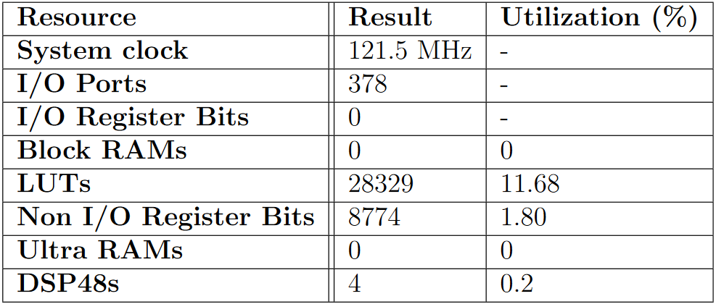
Synthesis results
Once verified, the architecture was synthesized
  Xilinx Kintex Ultrascale XCKU040
  No vendor-specific libraries used → Technology-agnostic architecture
Obtained synthesized results:
Synthesis
CDS Retirement is the most critical part
  CDS Reorder & Retirement Units use ~40% LUTs
  System clock critical path located inside FSM4
Frequency of 121.5 MHz
  7.8 Gbps maximum input throughput
Notes:
Same family as the radiant tolerant Kintex UltraScale XQRKU060

Slide 20
Synthesis results
Comparison against original 121.0 SHyLoC:
  3x throughput increase
  Hardware occupancy increases as well due to the inclusion of multiples lanes
    Generation of a unified bitstream has a significant impact
Resource | SHyLoC 121.0-B-3 | Parallel121
System clock (MHz) | 160.2 | 121.5
Throughput (Gbps) | 2.56 | 7.78
I/O Ports | 204 | 378
Block RAMs | - | -
LUTs | 3708 | 28329
FFs | 1560 | 8774
DSPs | 4 | 4
Synthesis
Notes:
The weight vector is updated according to the prediction error.

Slide 21
Contents
Introduction and motivation
Architecture
Verification and synthesis
Conclusions
Context and background

Slide 22
Conclusions
VHDL Design and verification of a CCSDS 121.0-B-3 high-performance, parallel compressor system.
  Both prediction and codification blocks parallelized
  Operation-based control scheme
    Effectively removes the Zero-Blocks dependencies
    Coordination of the coding lanes is a centralized mechanism
    Unified bitstream generation
  Scalable architecture
    Duplication of the basic coding lanes
Architecture verified through two different verification campaigns
Synthesis results demonstrate the viability of the solution
  Minimal hardware resource occupancy (~11% LUTs, ~2% FFs, 4 DSPs, No BRAMs)
  System clock 121.5 MHz, 7.8 Gbps

Slide 23
CCSDS121-based High-Performance Hardware
Architecture for Real-Time Data Compression
Samuel Torres Fau, Antonio J. Sánchez, Yubal Barrios and Roberto Sarmiento
5th October 2023

