Slide 1
MODELISATION AND SIMULATION OF THE DEGRADATION PROCESS OF SCAFFOLDS DEVELOPED BY ADITIVE MANUFACTURING AND BIOMATERIALS
Jacob Abdelfatah
Rubén Paz
Mario Monzón
Gabriel Winter
Notes:
Good afternoon. I would like to introduce myself. My name is Jacob Abdelfatah. I will give you a brief presentation about this work, named “Modelisation and simulation of the degradation process of scaffolds developed by aditive manufacturing and biomaterials”. I made this work in colaboration with teachers of my university. Their names are shown in this slide.

Slide 2
Outline
Title of the paper title
First Author et al.
Motivation
Background
Materials
Methodology
Geometrical Model
Mesh
Simulation
Results
Discussion
Conclusions
Future Work

Slide 3
Motivation
SCAFFOLDS ARE POROUS GEOMETRIES THAT ARE DESIGNED TO ALLOW THE PROLIFERATION OF CELLS INSIDE OF IT.
SCAFFOLDS WITH MICROARQUITECTURES ARE USED IN COMBINATION WITH CELLS TO IMPROVE THE PROLIFERATION.
RESORBABLE SCAFFOLDS HAVE THE ADVANTAGE OF SERVING AS TEMPORAL STRUCTURES THAT CAN BE DEGRADED AND RESORBED BY THE BODY, THUS AVOIDNG POTENTIAL PROBLEMS SUCH AS INFECTIONS AND SURGERIES
THE ADVANTAGES OF USING RESORBIBLE POLYMERS AND THE GROWING USE OF ADITIVE MANUFACTURING HAS INCREASED THE INTEREST IN THESE MATERIALS.
DESPITE THE ADVANTAGES OF BIODEGRADABLE MATERIALS, IT IS IMPORTANT TO KNOW THE DEGRADATION RATIO CAUSED BY THE BIOLOGICAL FLUIDS AND MECHANICAL PROPERTIES OVER TIME BEFORE IMPLANTATION.
THEREFORE, THIS LINE OF RESEARCH AIMS TO DEVELOP COMPUTATIONAL MODELS TO SIMULATE THE DEGRADATION PROCESS OF THE SCAFFOLDS AND THE EVOLUTION OF THE MECHANICAL PROPERTIES OF THIS STRUCTURES.
Notes:
The scaffolds are porous geometries, which allows the proliferation of cells to inside of it. For their part, The resorbable scaffolds are designed to serve as temporary structures that can be degraded and resorbed by the body. This advantages and the growing use of aditive manufacturing has increased the interest in these materials. Despite the advantages of these materials , it is important to know in advance de degradation ratio caused by the biological fluids and the evolution of the mechanical properties.

Slide 4
Background
Chen et al.(2011) proposed a methodology to determine the homogeneous shear stress field in a Surface using evolutive algorithms.
Erkizia et al(2010), defined a methodology to obtain the degradation by only the exposure to the fluid, using the Montecarlo algorithm.
Saad et al.(2017) proved by experimental tests the influence of flow rates on the degradation tests. By digital reconstruction of the geometry(μCT) and performing a CFD simulation on it, they obtained the shear stress field on the Surface at different degradation time.
Shirazi et al.(2016) defined a scheme of simulation that predicts the mass loss properties of the polymer and the subsequent loss of material properties. The model is based on the reaction-diffusion equation
Notes:
Different authors approached in the treatment of the degradation process in different ways. Chen proposed a methodology to control the degradation process by defining the optimum conditions to create a homogeneus shear stress. For his part, Erkizia performed a simulation with static Flow conditions and using the criterio of the exposure of the cells on the fluid. Saad made a different reconstructions of the degraded geometry in in-vitro tests and obtained the shear stress field at different degradation times. Finally Shirazi defined a numerical scheme to correlate the evolution of the mechanical loss properties using the reaction-difusión equation.

Slide 5
Materials
Bio-fluid within scaffold microstructures transports nutrients and metabolites to maintain a newly-regenerated tissue alive.
Joints present a particular case of the scaffolds because of the synovial fluid, which accelerates the degradation process, due to the enzymes present on it.
So its of capital importance to choose the proper material to ensure the degradation process, due to the enzymes present on it.
For the simulations, PLA scaffolds will be considered.
As the synovial fluid is non Newtonian, the formulation and resolution of the Navier Stokes equations are more complex.
PBS, although is a Newtonian fluid, behaves in a similar way, so we are going to consider it in our simulation.
Notes:
Biofluids like synovial fluids present enzymes that speeds up the degradation process. So, it is important that the materials of the scaffold would be capable to maintain its structure as long as the fluid passes through it. Indeed, it is important that scaffolds are biocompatible. Therefore, PLA scaffolds were considered. Another properties of the synovial fluid is that it doesn’t have Newtonian characterisitics. Therefore, Polybutilene succinate(PBS) is considered due to its similar behaviour and its Newtonian properties.
As the synovial fluid is non Newtonian, we are considered PBS as fluid because of its similar behaviour.

Slide 6
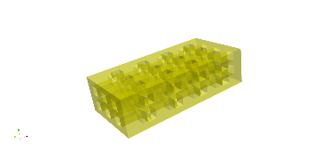
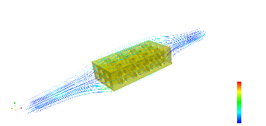
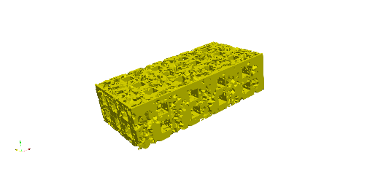
Methodology
INITIAL GEOMETRY
CFD CALCULATION(VELOCITY AND SHEAR STRESS)
MASS DEGRADATION CRITERIA
UPDATED MESH
Δt
Notes:
This is the scheme of the process, which i will explain below in more detail.

Slide 7
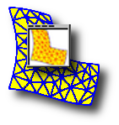
Software
Notes:
The modelisation and simulations were carried out using the following open-source softwares.

Slide 8
Geometrical model
Approximate dimmensions
Depth: 10mm
Diameter: 10mm
Pore Size: 0.5mm
Notes:
Our scaffold model has a 10 mm Depth, as well as its diameter, and a 0.5mm pore size.

Slide 9
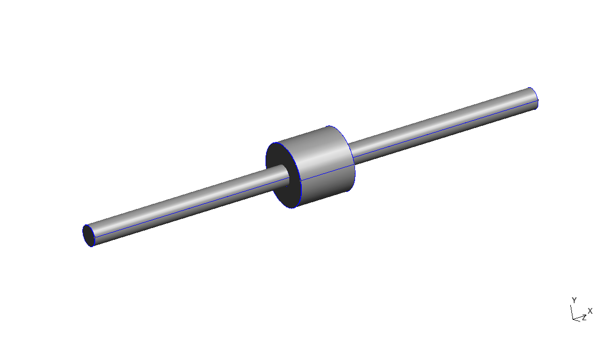
Geometrical model
Inlet Channel and Outlet channel
Depth: 40mm
Diameter: 4mm
Chamber
Depth: 11mm
Diameter: 12mm
Notes:
For the simulation, according to Saad et al(2017). This scaffold will be placed in a small chamber, and the Flow condition is adjusted from the inlet and outlet channel.

Slide 10
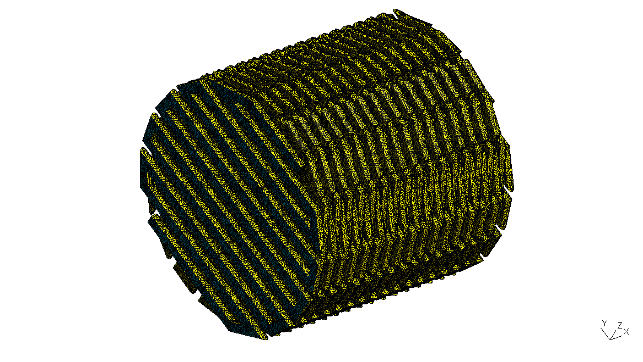
Mesh
Uniform mesh size:0.1 mm
Notes:
Once the model is defined. We create a proper mesh for the domains. In the case of the scaffold, the mesh size is of 0.1mm.

Slide 11
Mesh
External mesh size:0.5mm
Internal mesh size:0.1 mm.
Notes:
The fluid space will be delimited externally by the walls of the chamber and the channels, and internally by the scaffold.

Slide 12
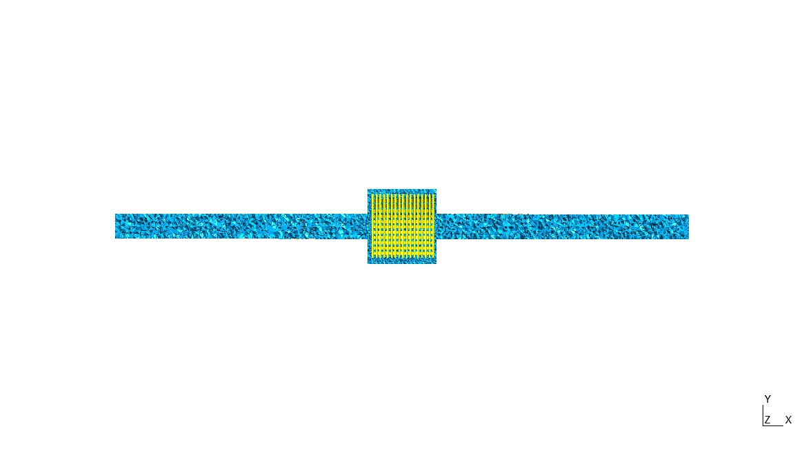
Mesh
External mesh size:0.5mm
Internal mesh size:0.1 mm.

Slide 13
Simulation Algorithm
The flow simulation was carried out with two Navier Stokes-based mathematical models:
Chorin-Rannacher Projection Method
Uzawa Conjugate Gradient with preconditioner of Cahouet-Chabart.

Slide 14
Simulation Algorithm
Chorin-Rannacher Projection Method
We use a modified Chorin projection method with improvement accuracy in the pressure :
$\frac{∂u}{∂t}+u∇u$ is approximated by the method of characterisitics
$$−∆p^{m+1}=−∇∙u^{m}oX^{m}, θ_{n}p^{m+1}=0$$
$$uoX\left(x\right)=u\left(x−u\left(x\right)δt\right)$$
$$\frac{1}{δt}\left[u^{m+1}−u^{m}oX^{m}\right]+∇p^{m}−v∆u^{m}=0, u\left|Γ=u_{Γ}\right.$$
(1)
(2)
(3)
Notes:
Es un método DNS (Direct Numerical Simulation) por tanto preciso para mallados pequeños, utiliza como vemos el método de característica para evaluar la velocidad en el tiempo anterior en la posición de la particula de fluido donde se encontraba en ese tiempo anterior, con el freefem++ disponemos para ello de una instrucción denominada convect para (3)

Slide 15
Simulation Algorithm
Chorin-Rannacher Projection Method
An improvement of the original chorin algorithm consists in considering “pressure stabilization”
$$−∆q=∇u+\overline{∇u}$$
And then:
$$u^{m+1}=\overline{u}+∇q∙δt, p^{m+1}=p^{m}−q−\overline{p^{m}−q}$$
(3)
(4)
(5)
Notes:
Rannacher propuso una modificación algo sotisficada de corrección de la presión en cada iteración , que es expresada en esta pantalla . Rannacher proposed a methodology to correct the pressure in each iteration, which is can be shown in this slide.

Slide 16
Simulation Algorithm
Chorin-Rannacher Projection Method
An improvement of the original chorin algorithm consists in considering “pressure stabilization”
$$−∆q=∇u+\overline{∇u}$$
And then:
$$u^{m+1}=\overline{u}+∇q∙δt, p^{m+1}=p^{m}−q−\overline{p^{m}−q}$$
(3)
(4)
(5)
Approximates by the mean
Value in each step

Slide 17
Simulation Algorithm
Chorin-Rannacher Projection Method
q=-p in an iterative process in which $p_{n}→\overline{p_{n}}=\frac{\int_{Ω}{p_{n}dΩ}}{area(Ω)}$
It is established that:
or
(6)
(7)
$$q=p_{n}−\overline{p_{n}}+\overline{q}−p$$
Notes:
En cada iteracion de corrección de la presión lo que se pretende es estabilizar la convergencia, de modo que hay un paso donde la presión se hace tender converga a la presión promedio y finalmente a la presión exacta o real.
In each iteration of correction of the pressure what is intended is to stabilize the convergence, so that there is a step where the pressure is made tend to converge to the average pressure and finally to the exact or actual pressure

Slide 18
Simulation Algorithm
Uzawa conjugate gradient
Navier Stokes equations, when its solved using Finite element methods, without penalty gives the following matricial expresión:
$$\left(\begin{matrix}A & B^{T} \\ B & 0\end{matrix}\right)\left(\begin{matrix}u \\ p\end{matrix}\right)=\left(\begin{matrix}b \\ c\end{matrix}\right)$$
Being u the velocity vector and p the pressure. The expresión can be written as:
$$Au+B^{T}p=b$$
$$Bu=c$$
(8)
(9)

Slide 19
Simulation Algorithm
Uzawa conjugate gradient
Operating in (8):
$$BA^{−1}Au+BA^{−1}B^{T}p=BA^{−1}b$$
$Bu+BA^{−1}B^{T}p$=$BA^{−1}b$
$$BA^{−1}B^{T}p=BA^{−1}b−c$$
Naming $BA^{−1}B^{T}=E$ and $BA^{−1}b−c=β$
We have
$$Ep=β$$
E is symmetryc and definide positive, so we can apply the conjugate gradient to solve the problem.
(10)
Notes:
El método Uzawa obtiene la expresión (10) a partir de las operaciones matriciales expuestas en la pantalla

Slide 20
Simulation Algorithm
Uzawa conjugate gradient
Once p is calculated from (10) we can obtain the velocity from the expression (8).
There exists modifications that allows to acelerate the convergence process. One of them is the Cahouet-Chabart preconditioner, applied on the expression(8).

Slide 21
Simulation Algorithm
Wall Shear stress and degradation criteria condition.
Once the velocity is obtained, the wall shear stress distribution over the Surface can be obtained, in the case of the newtonian fluids, with the following expression.
$$τ_{w}=\sqrt{{\left[μ(\frac{∂u}{∂y}+\frac{∂v}{∂x})\right]}^{2}+{\left[μ(\frac{∂v}{∂z}+\frac{∂w}{∂y})\right]}^{2}+{\left[μ(\frac{∂u}{∂z}+\frac{∂w}{∂x})\right]}^{2}}$$
The evaluated distribution is compared with a previously fixed threshold value. If an element exceed this value, then its removed from the mesh, and added to the fluid domain.
(11)
Notes:
Assuming a Newtonian fluid, the wall shear stress can be obtained with the following expression. The evaluated
distribution is compared with a previously fixed threshold value. If an element exceed this value, then its removed from the
mesh, and added to the fluid domain.

Slide 22
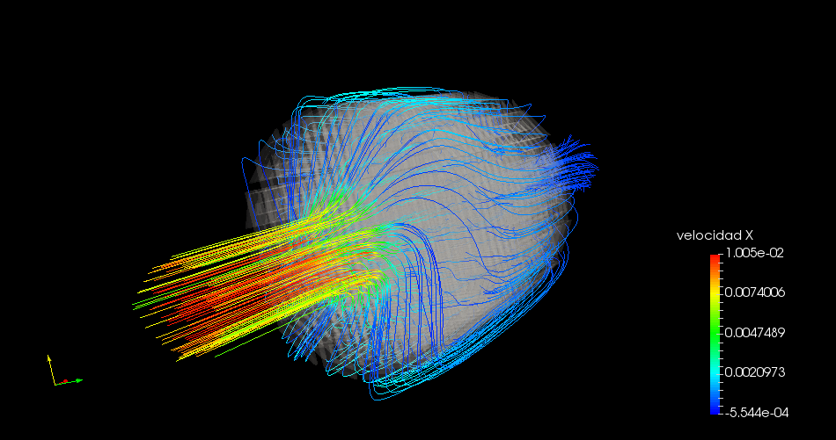
RESULTS
VELOCITY STREAMLINES
Notes:
Vamos a mostrarles algunos resultados preliminares. En primer lugar, mostramos la gráfica de velocidad obtenida para t=4. Vemos que la velocidad es mayor en la superficie que se encuentra en la entrada del scaffold.
We are going to show you some preliminary results. At first, we can see the velocity streamlines. The velocity is higher at the entrance of the chamber. So it is of capital importance

Slide 23
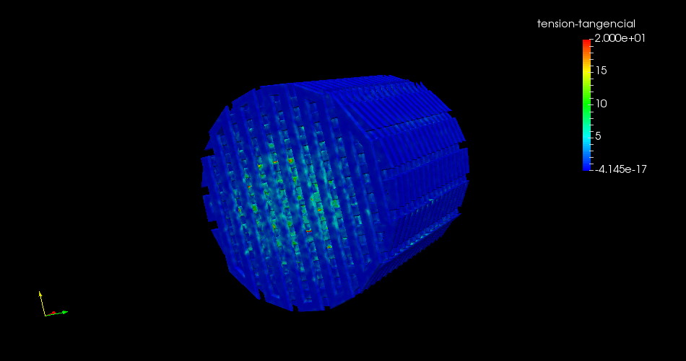
RESULTS
SHEAR STRESS FIELD.
Notes:
El mapa de tensiones tangenciales muestra un mayor valor en las zonas centrales debido a que la incidencia del flujo es directa en estas zonas. The shear stress field is initially higher in the central áreas at the entrance, because of the direct Flow incidence in this áreas.

Slide 24
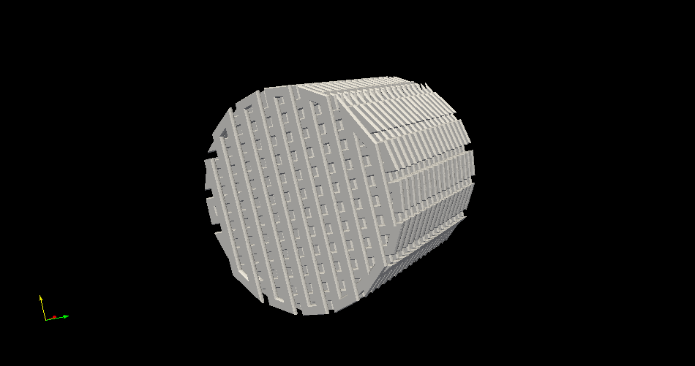
RESULTS
DEGRADATION EVOLUTION:t=0
Notes:
Therefore, in the succesive graphs we can see how the structure is degrading more and more in the central areas.

Slide 25
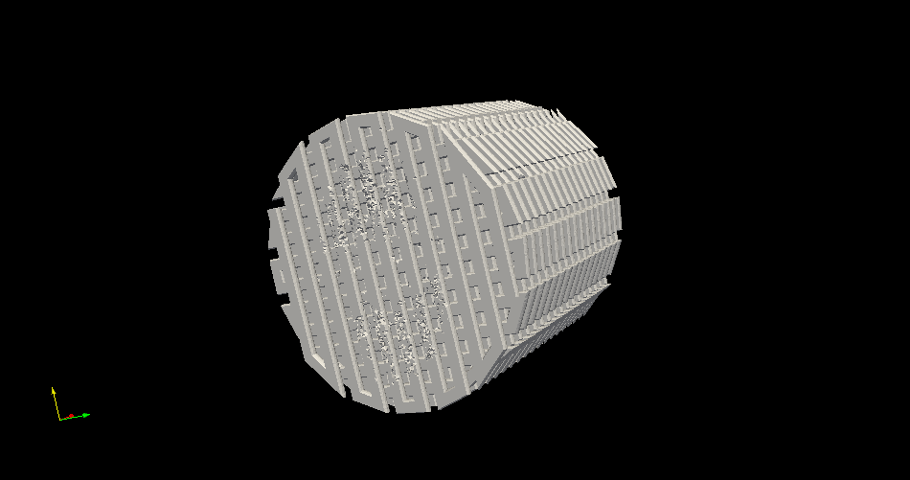
RSULTS
DEGRADATION EVOLUTION:t=0.005

Slide 26
RSULTS
DEGRADATION EVOLUTION:t=0.02

Slide 27
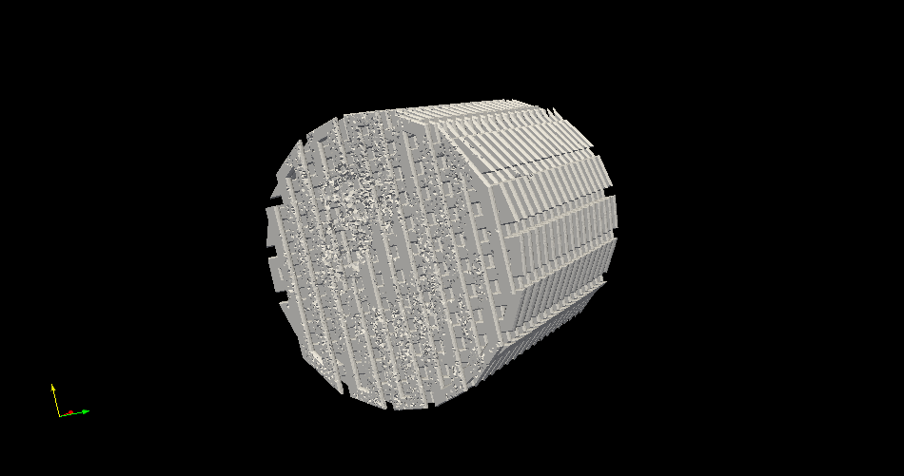
RESULTS
DEGRADATION EVOLUTION:t=0.037

Slide 28
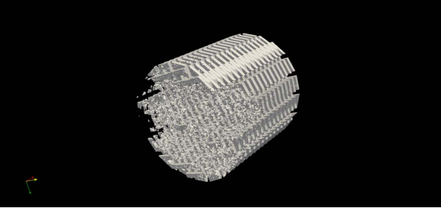
RESULTS
DEGRADATION EVOLUTION:t=0.05

Slide 29
Discussions
It is shown that the degradation rate is increased when the inlet rate is increased. It predominantly occurs at the entrance of the channel, according to Culter et al(1975).
According to standard designs of the polymerical scaffolds, and the in vitro tests(Saad et al.,2017), it is observed that we obtained a heterogeneous distribution of the wall shear stress. So it is not posible to create a homogeneous field regardless of the flow rate or the dimmensions of the domain.
According to the in vitro tests found in the literature, we can observe that the adjusting of the inlet flow rate to the dimmensions of the domain, generates a more smooth and stable degradation process.
The evolutionary Navier Stokes algorithm is applied in these work while previous Work have been used other techniques.
The static degradation of the scaffold has not been considered in this work.
Notes:
From the results, we can compare our results with those obtained in the literatura. At first it is shown that the degradation rate is increased and it predominantly occurs at the entrance according to Culter.
According to standard designs of the polymerical scaffolds and in-vitro tests, we cannot obtain an homogeneous shsear stress field.
According to the in vitro tests found in the literature, the adjusting of the Flow conditions generates a more smooth and stable degradation process.
The evolutionary Navier Stokes is applied in these work compared with another techniques.
The static degradation of the scaffold has not been considered in this work.

Slide 30
Conclusions
This work presents a numerical implementation of a methodology proposed to obtain degraded biopolymeric scaffolds under in vitro tests.
The work has been carried out according to the previous expertimental tests on scaffolds, under certain flow conditions.
The degradation process is due to the wall shear stress that exceeds a threshold value, arbitrarily assumed in this work.
It has been used a standard scaffold model to elaborate the process.
Two numerical-based Navier Stokes models were used for the Flow modelling:Uzawa-conjugate gradient and Chorin Rannacher projection method.
The process is relatively stable when the flow conditions are adjusted to the dimensions of the geometry.
Notes:
According of the conclusions, the following have been extracted:

Slide 31
Future work
The definition of mathematical correlation to estimate the degradation process for certain polymers of common use, based on experimental tests.
The prediction of the mechanical loss through compressions tests according to compression tests on the scaffold at different times steps.
The simulation of the tissue regeneration using finite element methods.

Slide 32
Acknowledgments
This work was funded by: FEDER/Ministerio de Ciencia, Innovación y Universidades – Agencia Estatal de Investigación/ Project DPI2017-88465-R. and Fondo de Ayudas a la Investigación Aplicada, University Foundation of Las Palmas(FULP)

Slide 33
MODELISATION AND SIMULATION OF THE DEGRADATION PROCESS OF SCAFFOLDS DEVELOPED BY ADITIVE MANUFACTURING AND BIOMATERIALS
Jacob Abdelfatah
Rubén Paz
Mario Monzón
Gabriel Winter
Notes:
And with this we end the presentation. Thanks for your attention.

